Slide 1

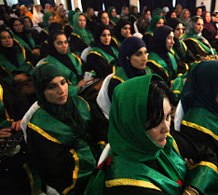
Prior to August 2021, there were approximately 270 Women Judges in Afghanistan

Slide 2
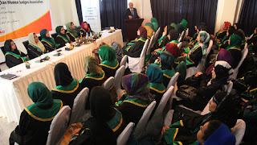

Slide 3
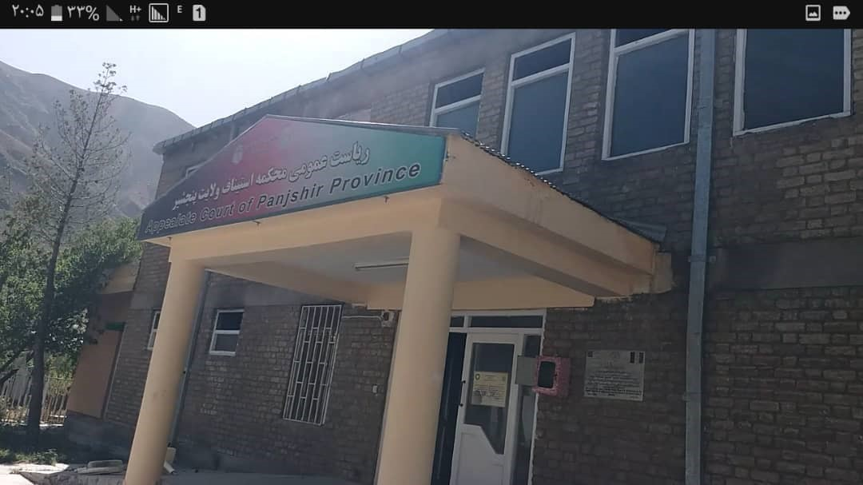
Judge Roeen’s Court –
The Appellate Court of Panjshir Province

Slide 4
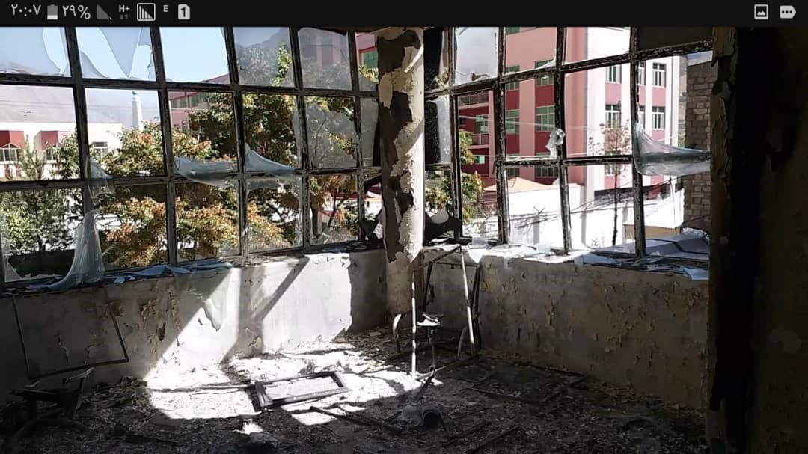
Burned courthouse August 2021

Slide 5
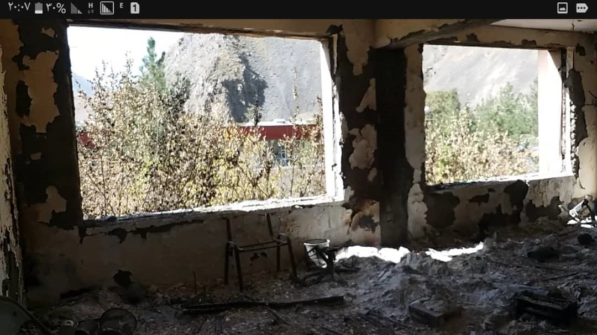
Burned courthouse August 2021

Slide 6
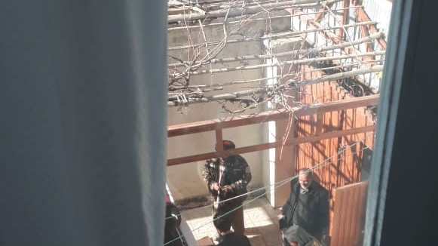
The Taliban at the Roeen’s home.

Slide 7
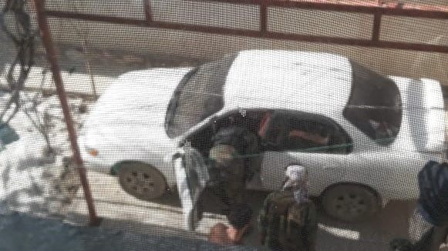
The Taliban searching
the Roeen’s car

Slide 8
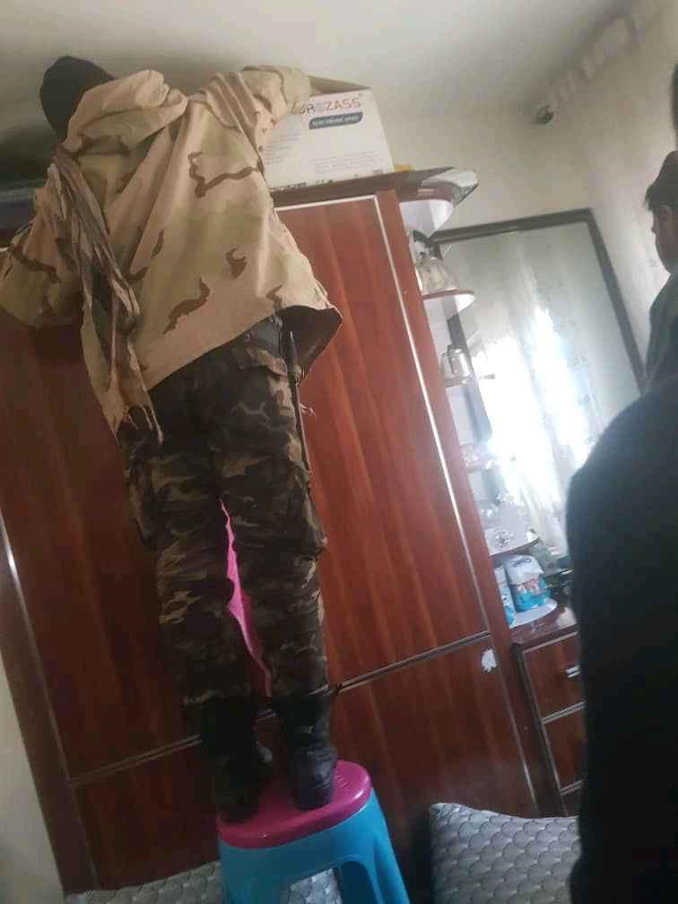
The Taliban searching
the Roeen’s
Home

Slide 9
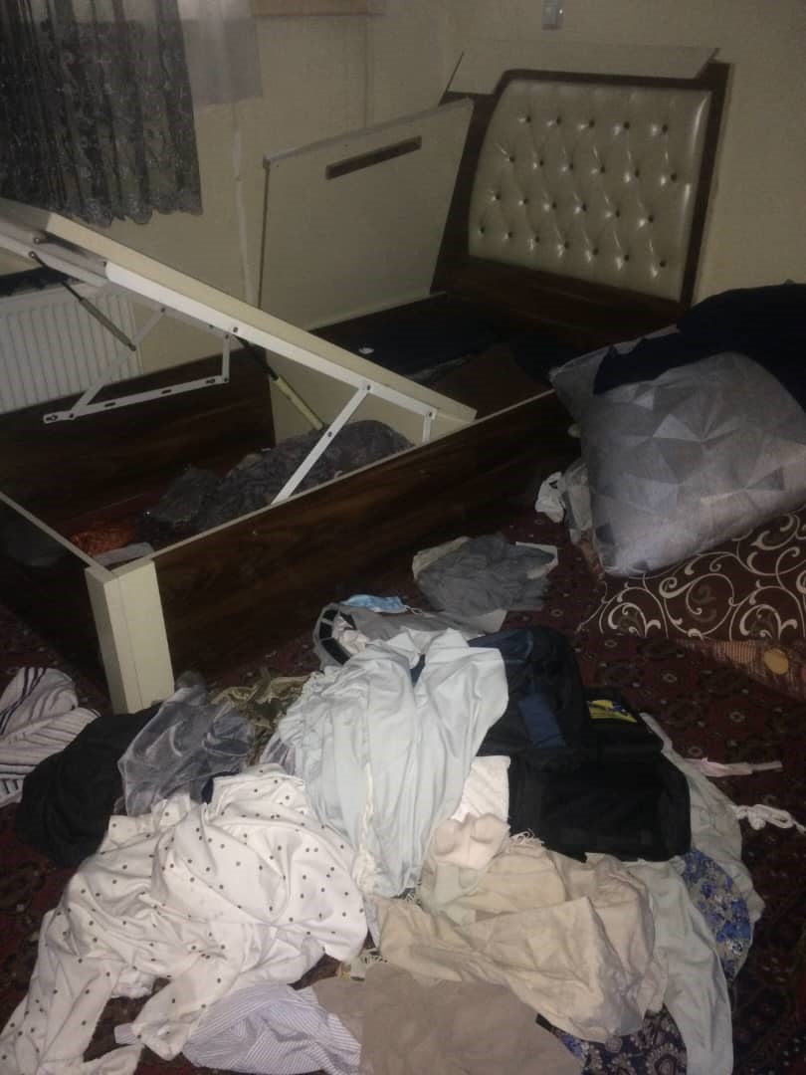
The Roeen’s home
being ransacked.

Slide 10
Refugee Camp
In the United Arab Emirates.

Slide 11
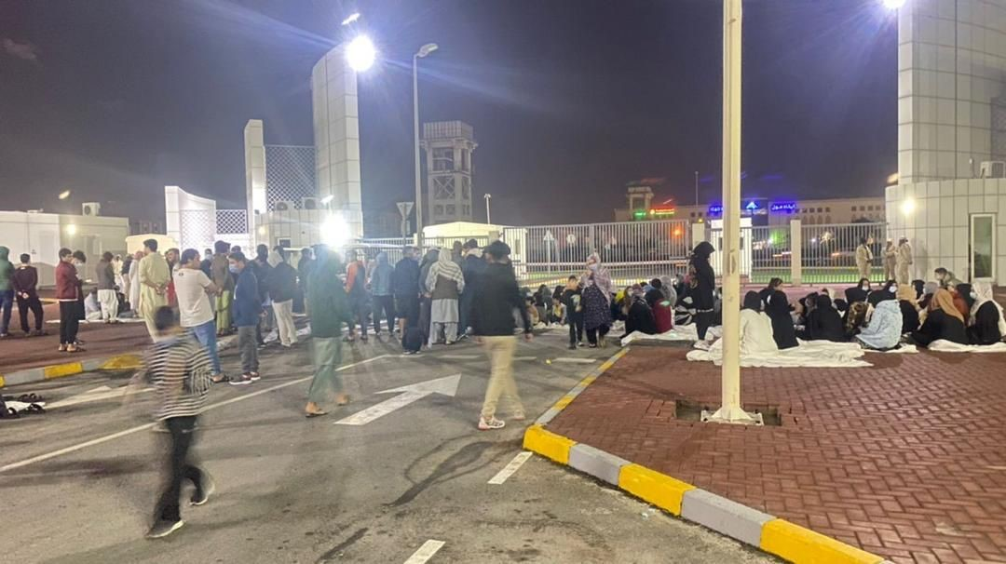
UAE refugee camp

Slide 12
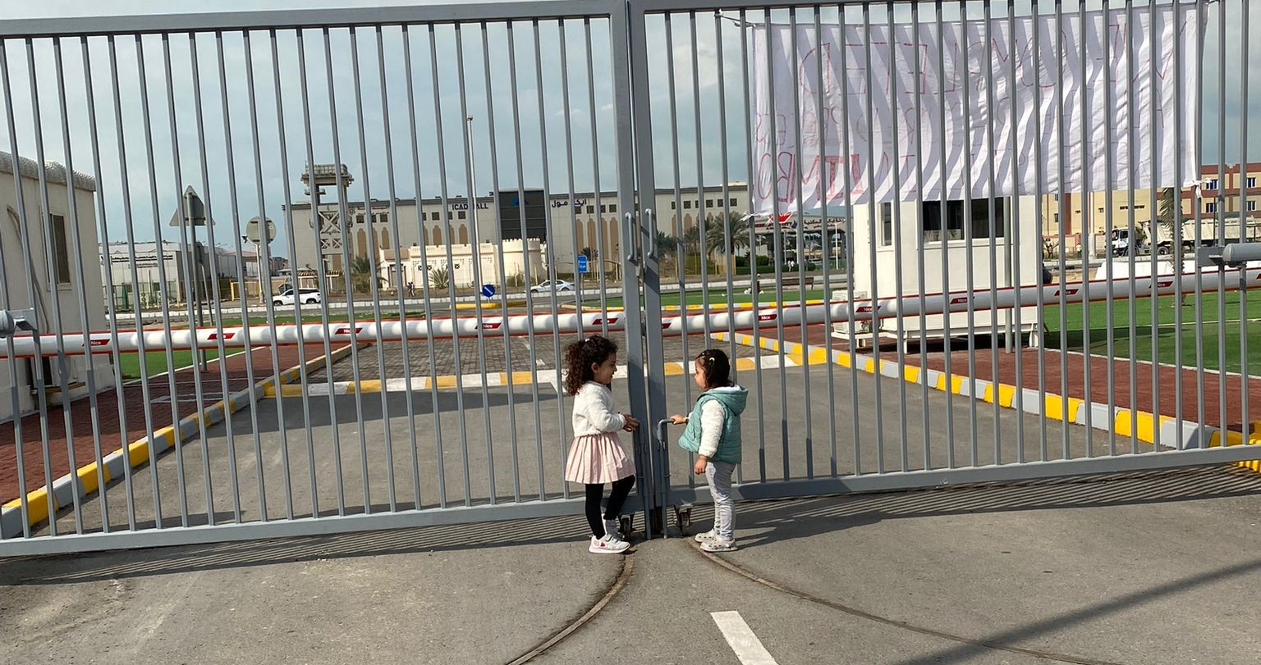

Slide 13
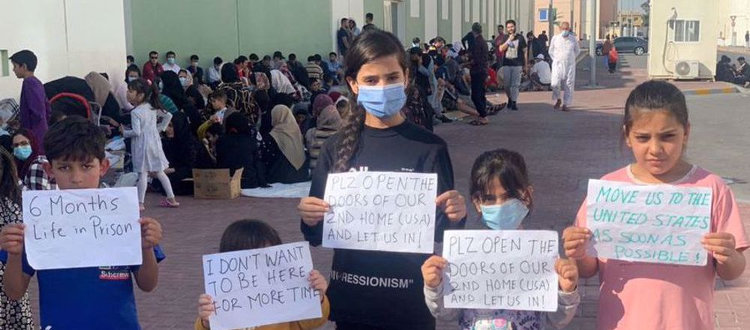
Protests in the UAE refugee camp

Slide 14

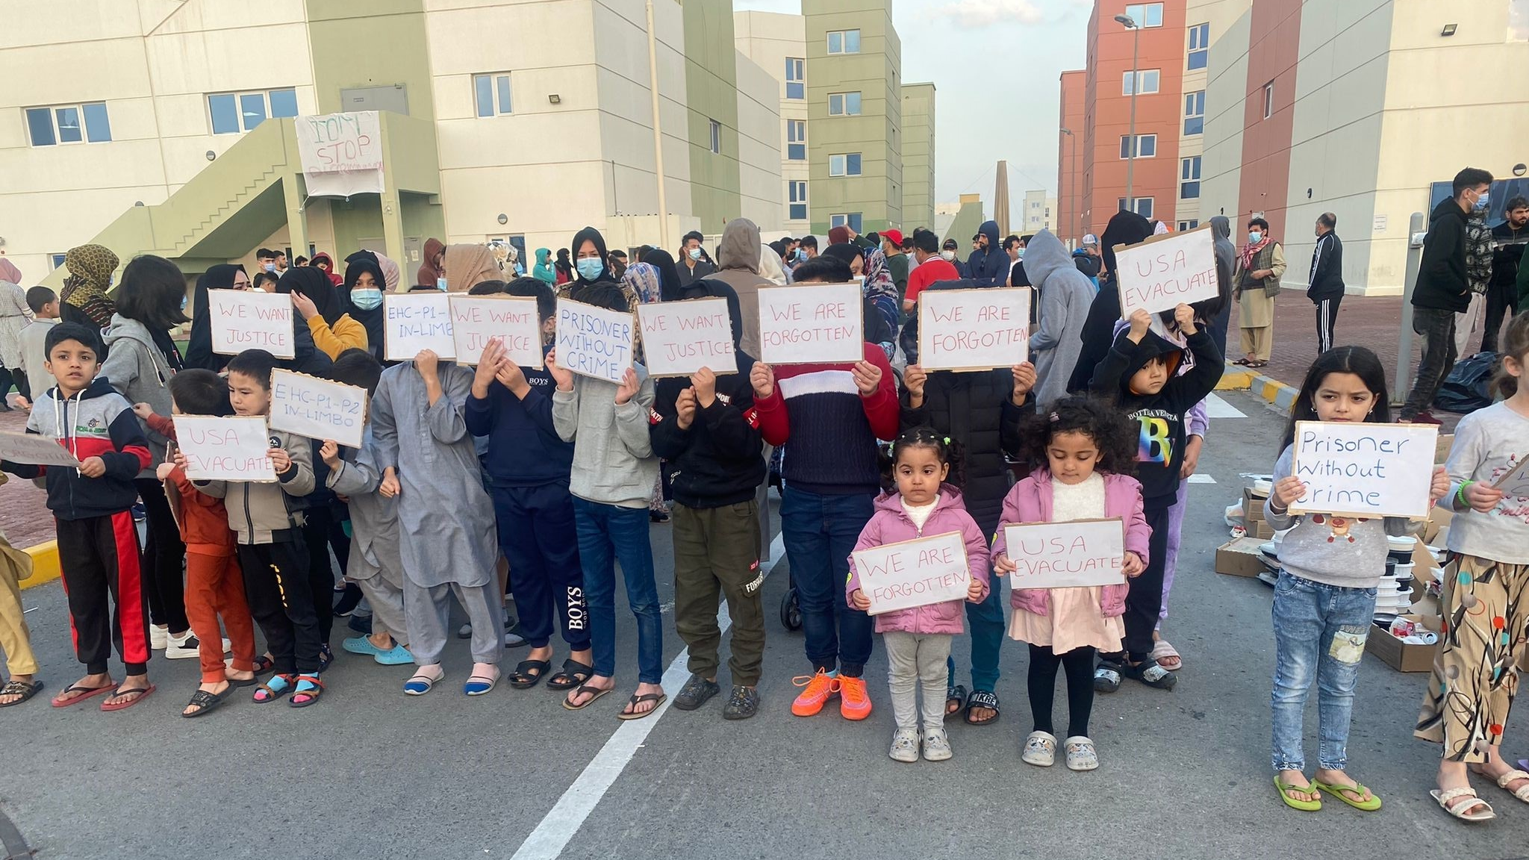

Slide 15
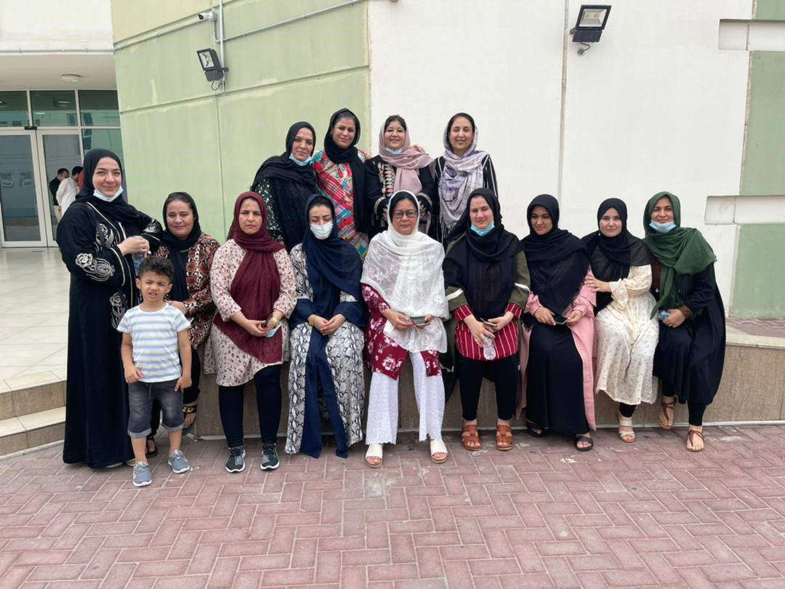
Judge Roeen and other Afghan women judges in the UAE refugee camp

Slide 16
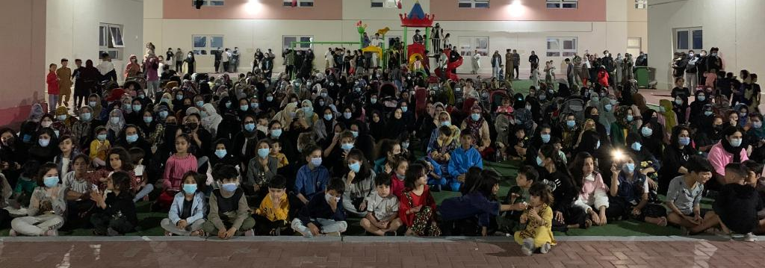
2 years and 20 days
since leaving Afghanistan.

Slide 17
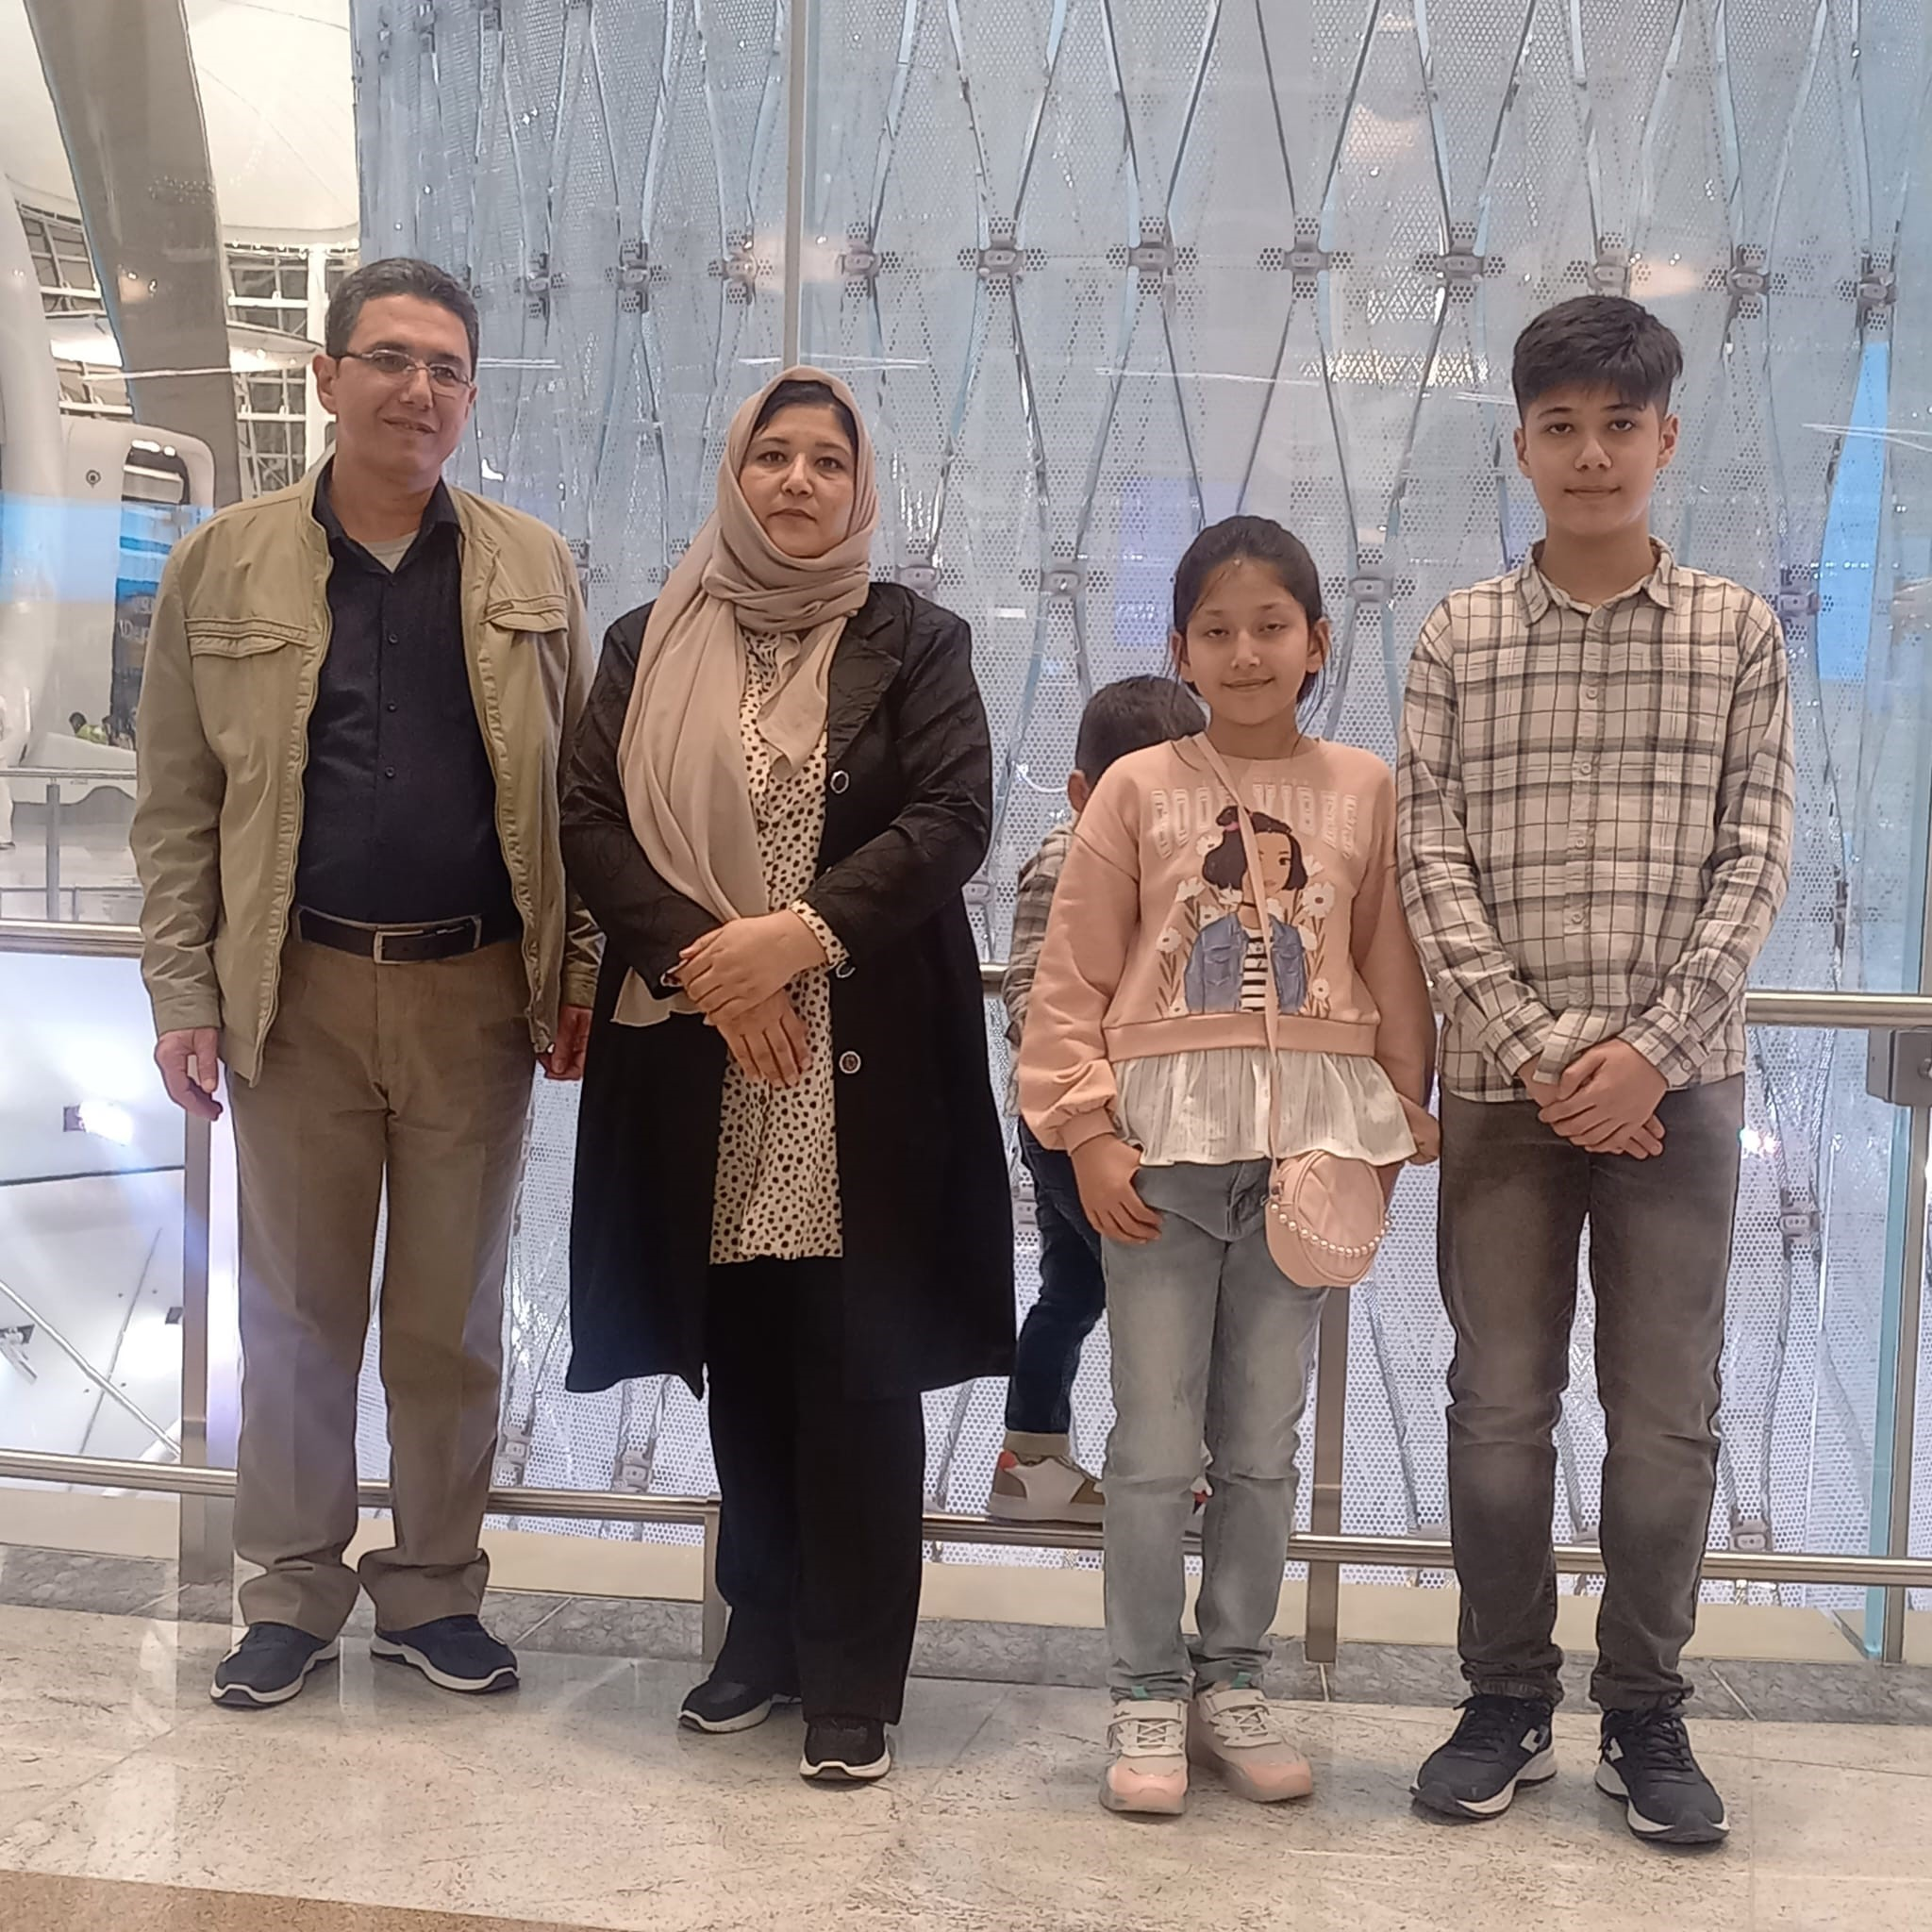

Finally on the way to America!!

Slide 18
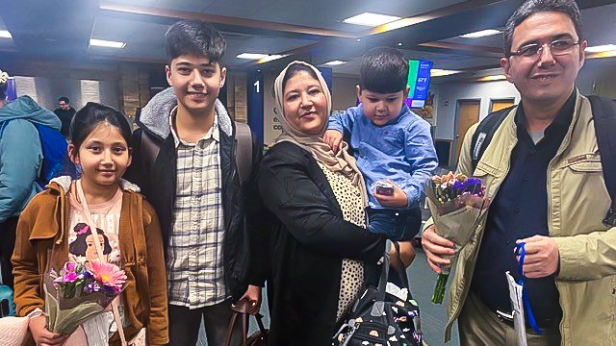
Arrival in the USA!
November 17, 2023

Slide 19
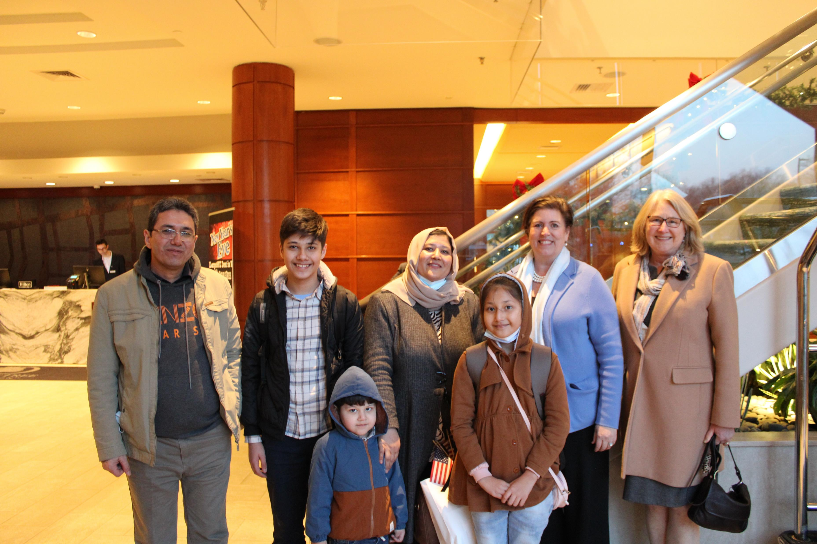
Arrival in
New Hampshire
November 28, 2023

Slide 20
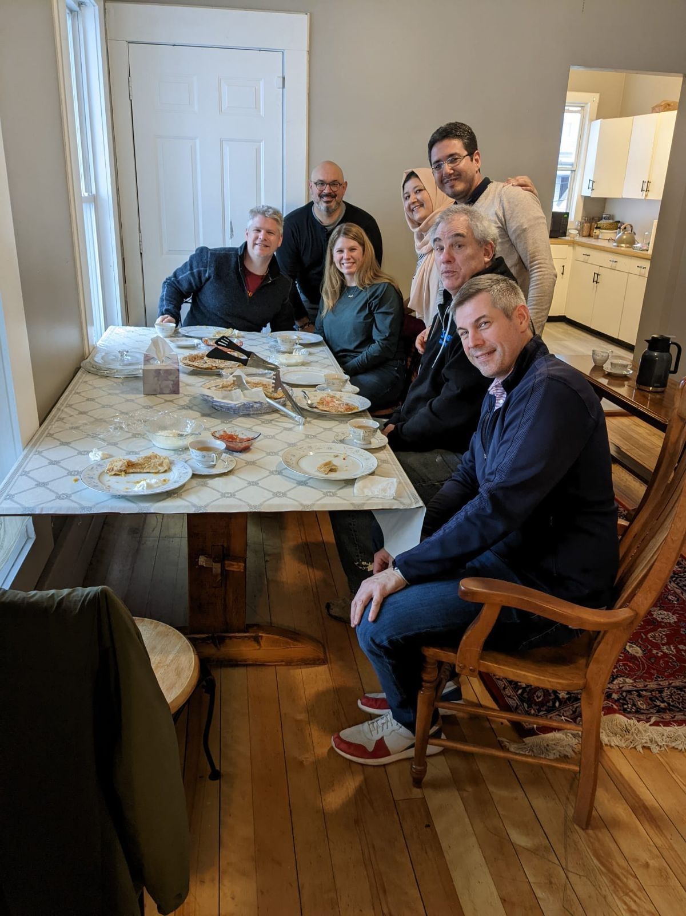
Attorney Glynn
& Family
Movers!

Slide 21
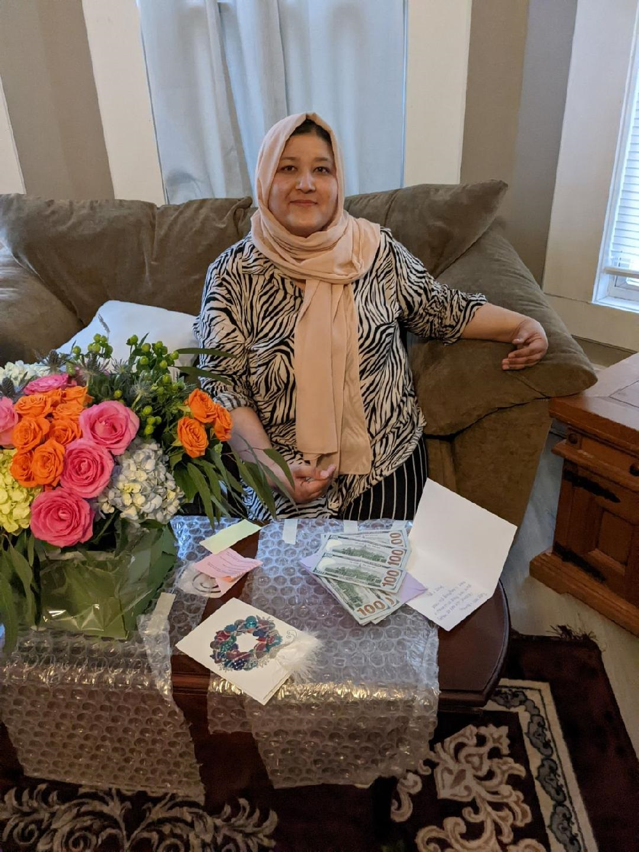

Slide 22
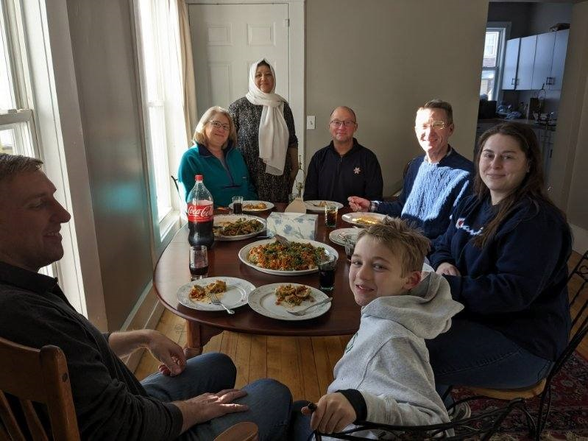
Hospitality with
Justice Hantz-Marconi
and volunteers

Slide 23

Shopping at Target with Federal Judge Johnstone and her Clerk Lauren

Slide 24
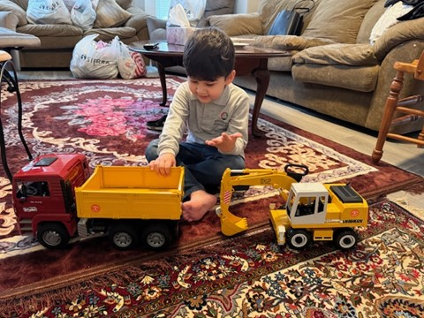

Slide 25
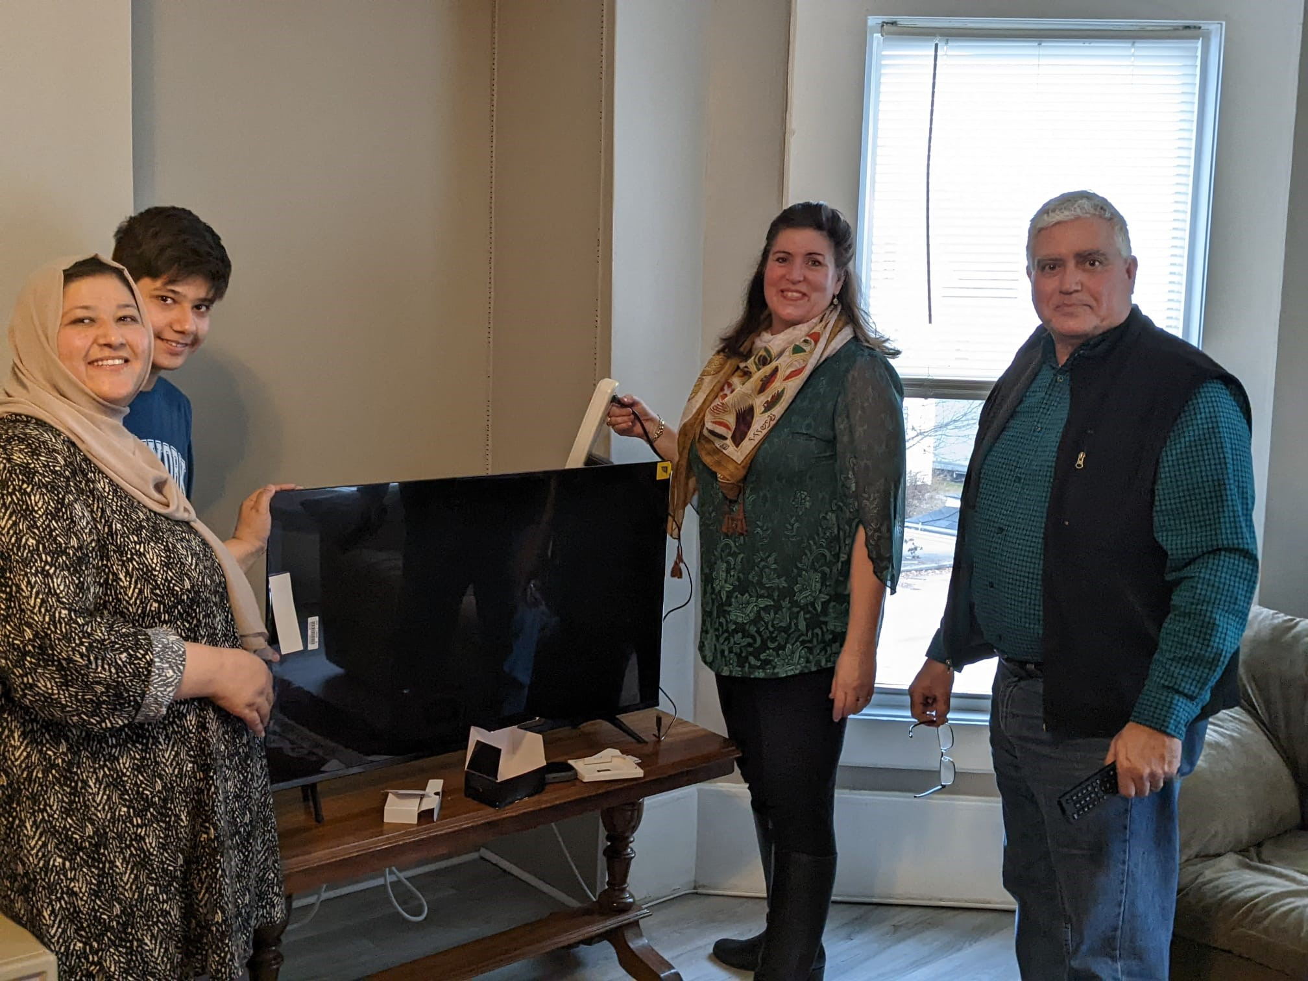
TV and WiFi hook up with Judge Christo and crew!

Slide 26
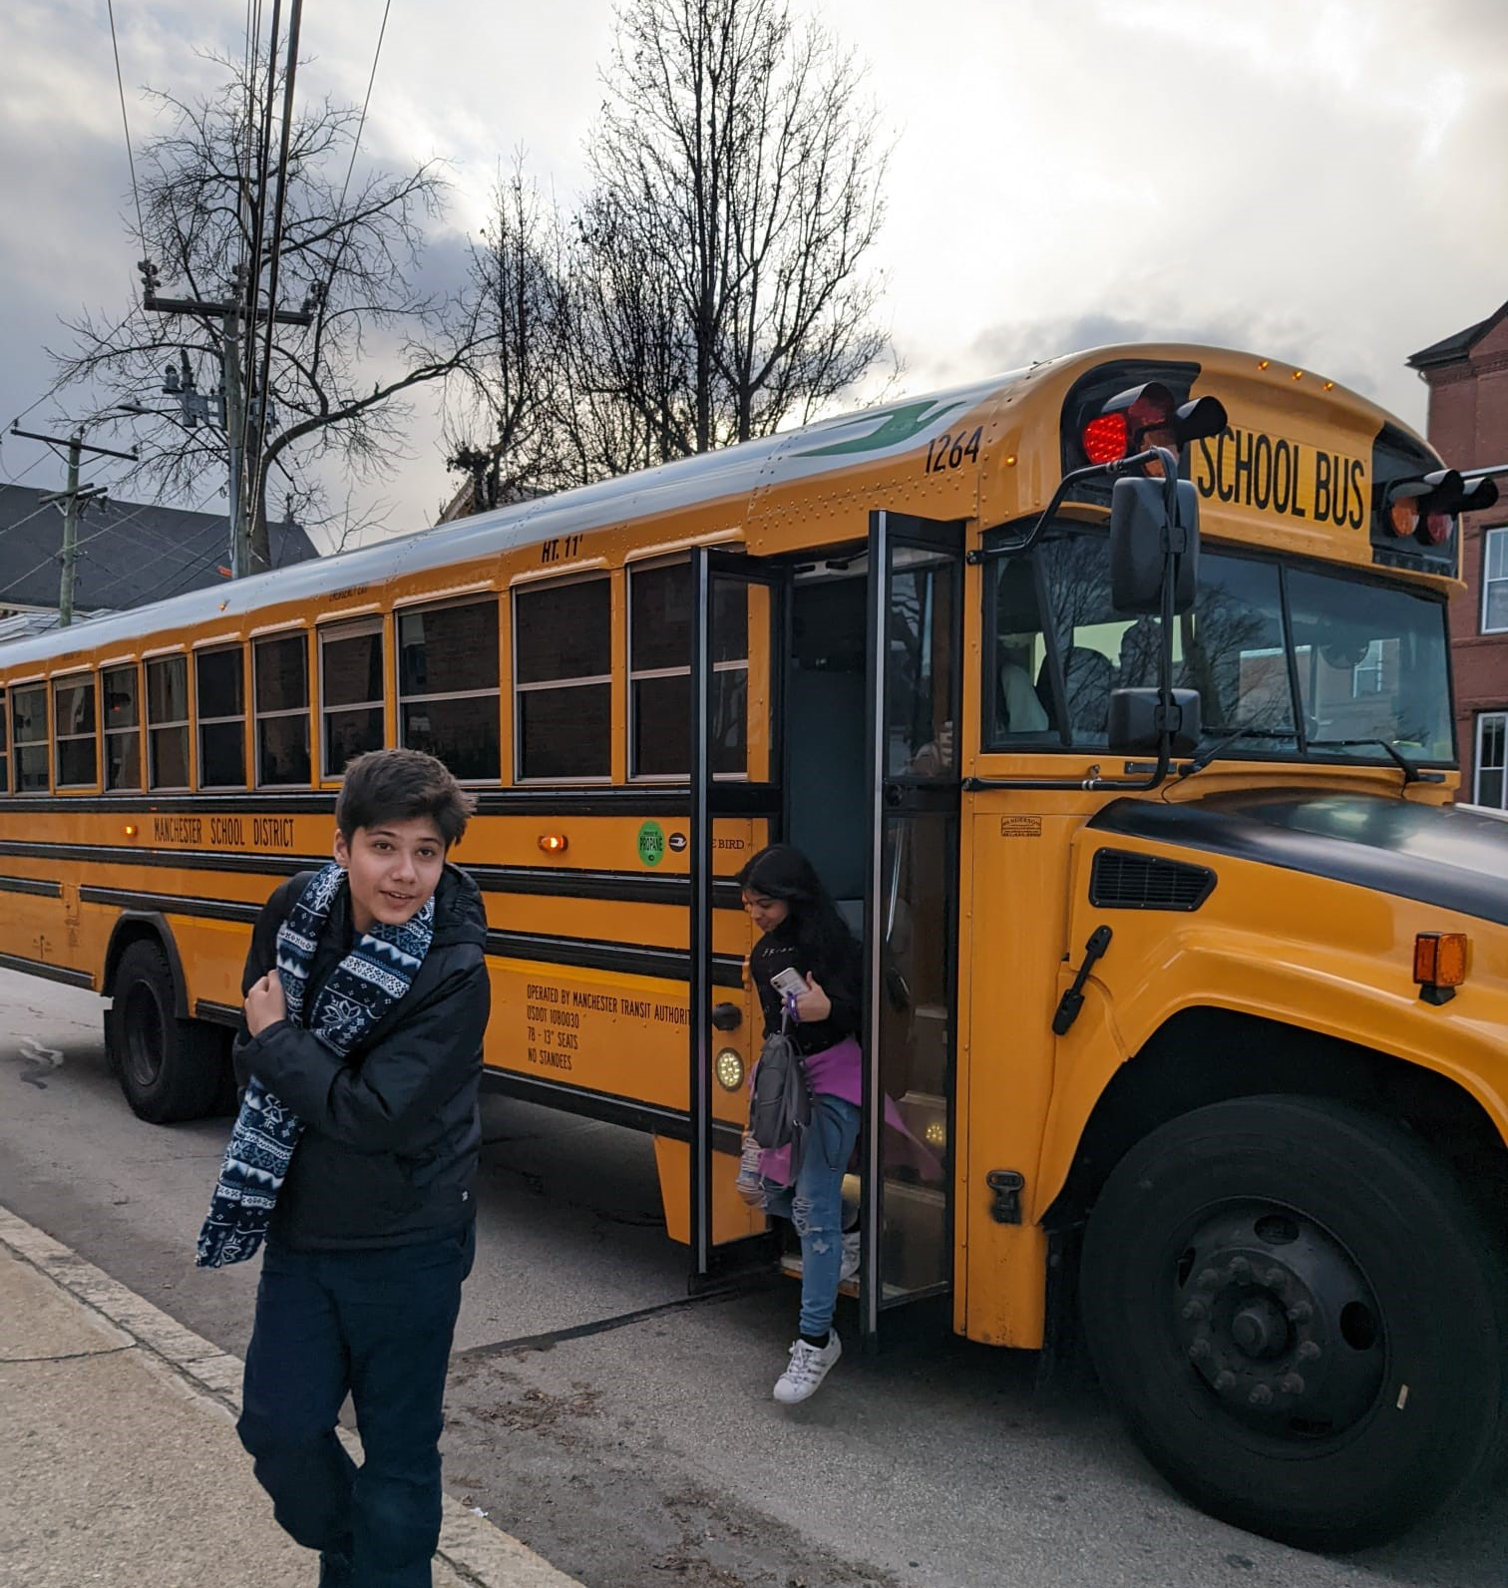
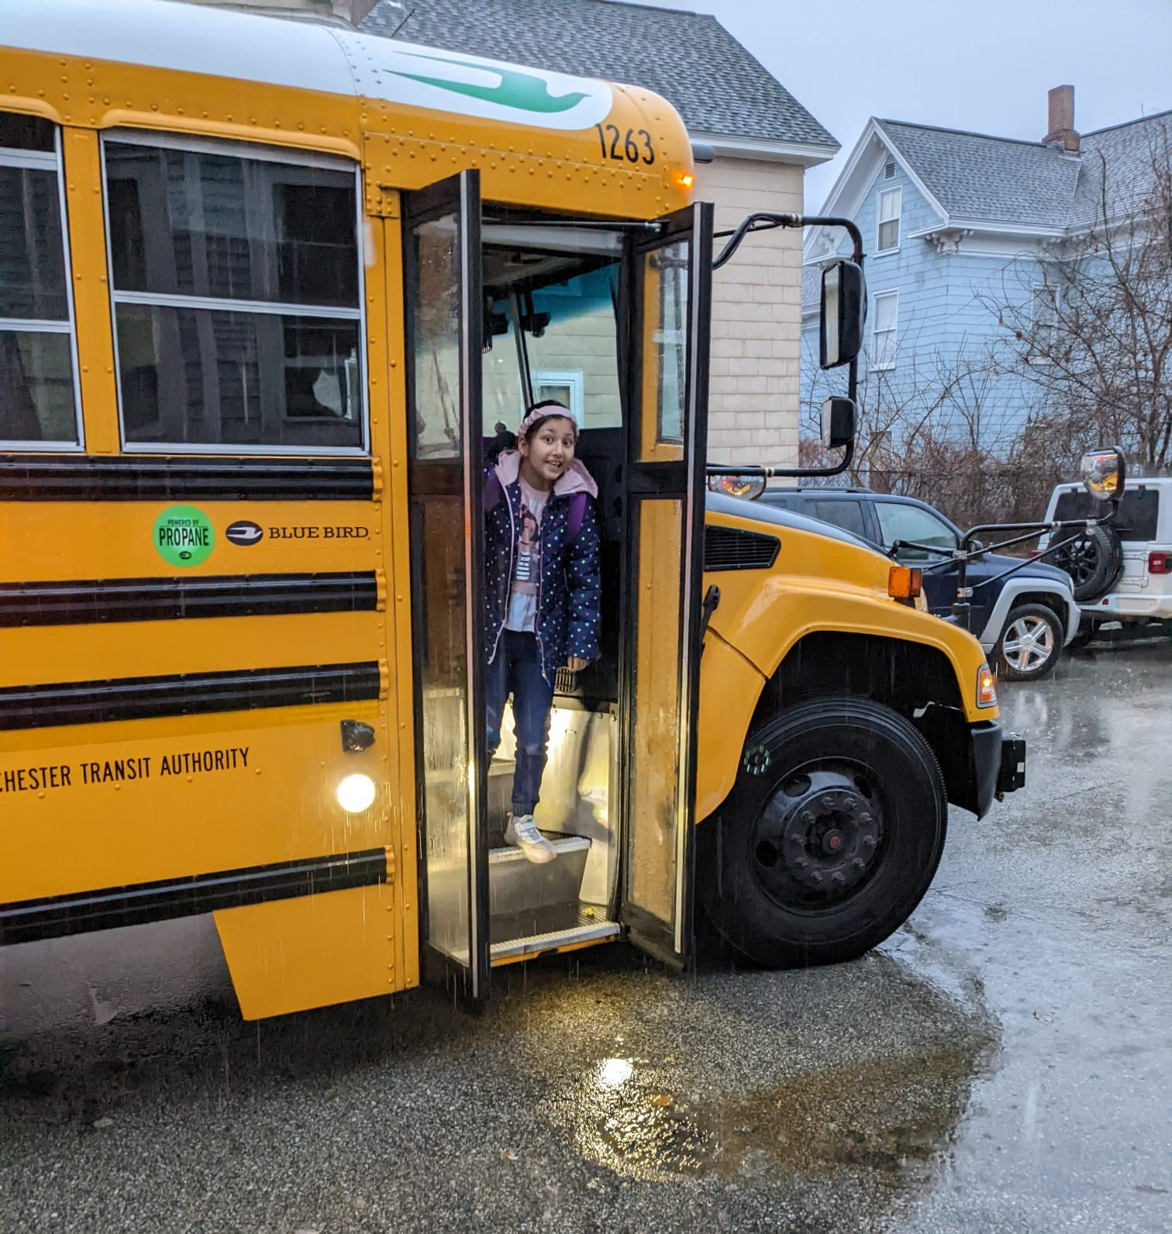
First day of school in over 2 years!

Slide 27

New Hampshire Driver’s License
with the help of instructor
Attorney Gifford!!

Slide 28

“New to you” car donated by
Attorney Christine Gordon

Slide 29
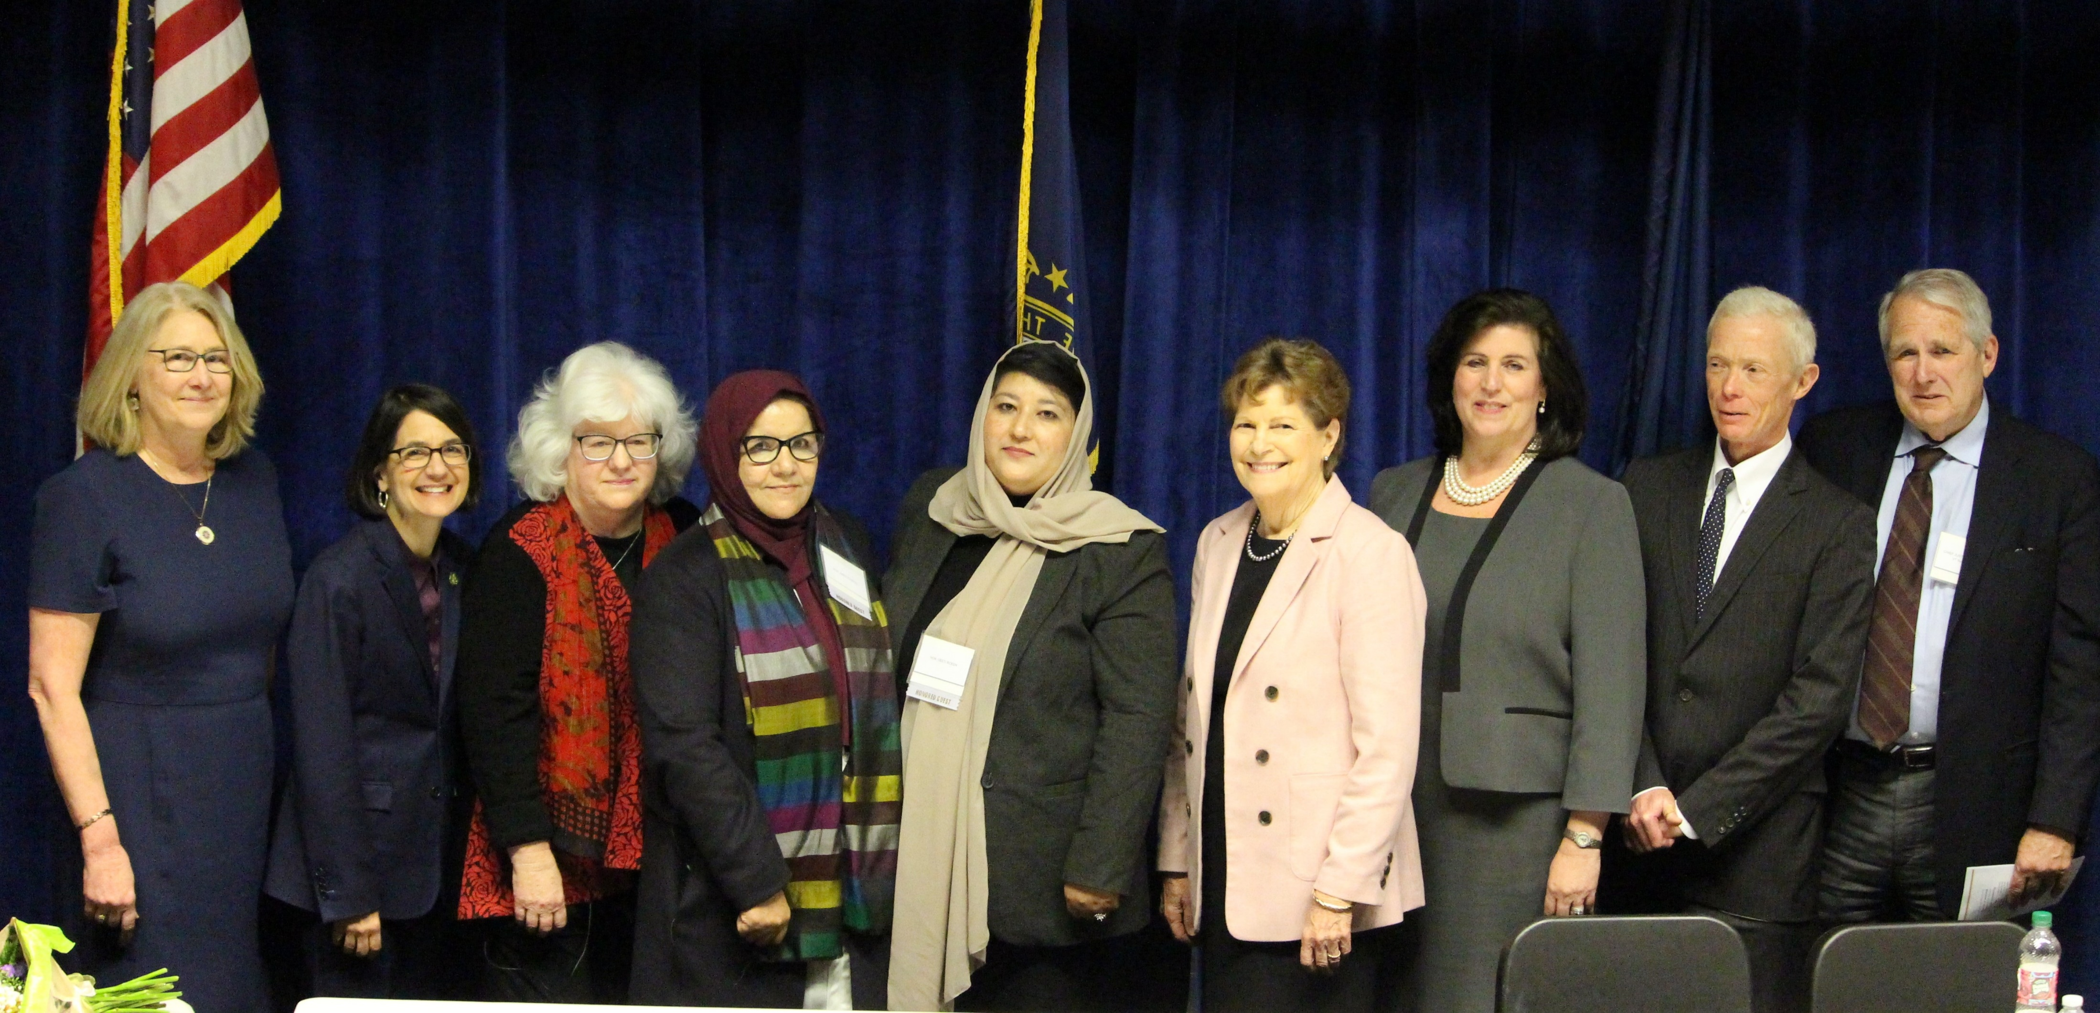
OFFICIAL WELCOME CEREMONY
JANUARY 2024

