Slide 1

ABA: Looking Ahead
ABA President-Elect Candidate
Laura V. Farber
November 8, 2025

Slide 2
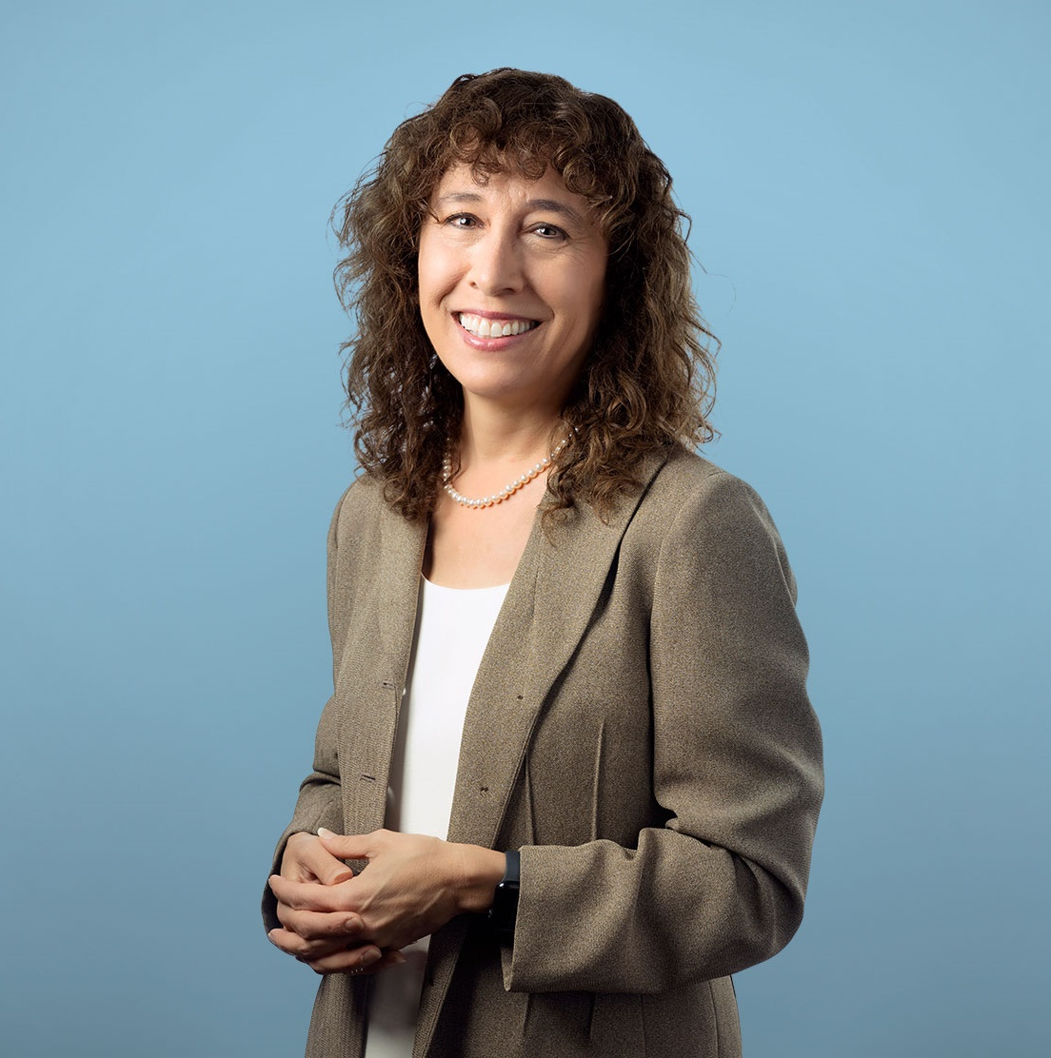

Building on Strengths, Shaping Tomorrow

Slide 3
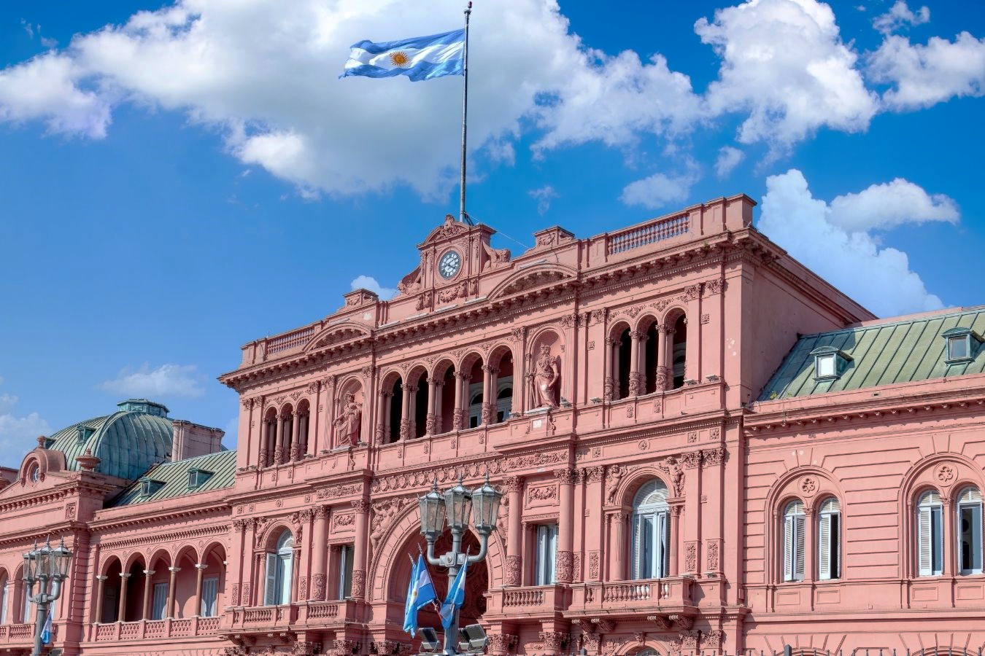
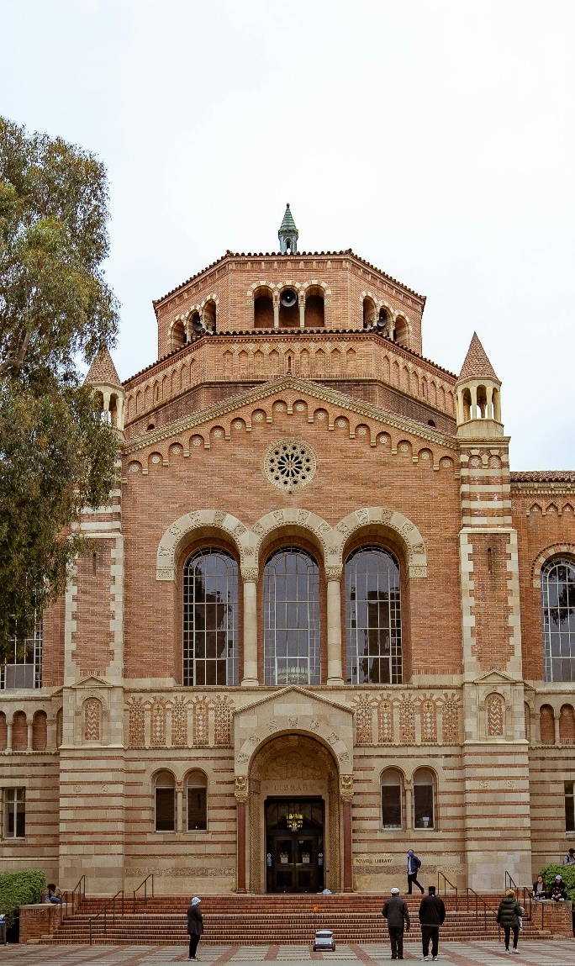
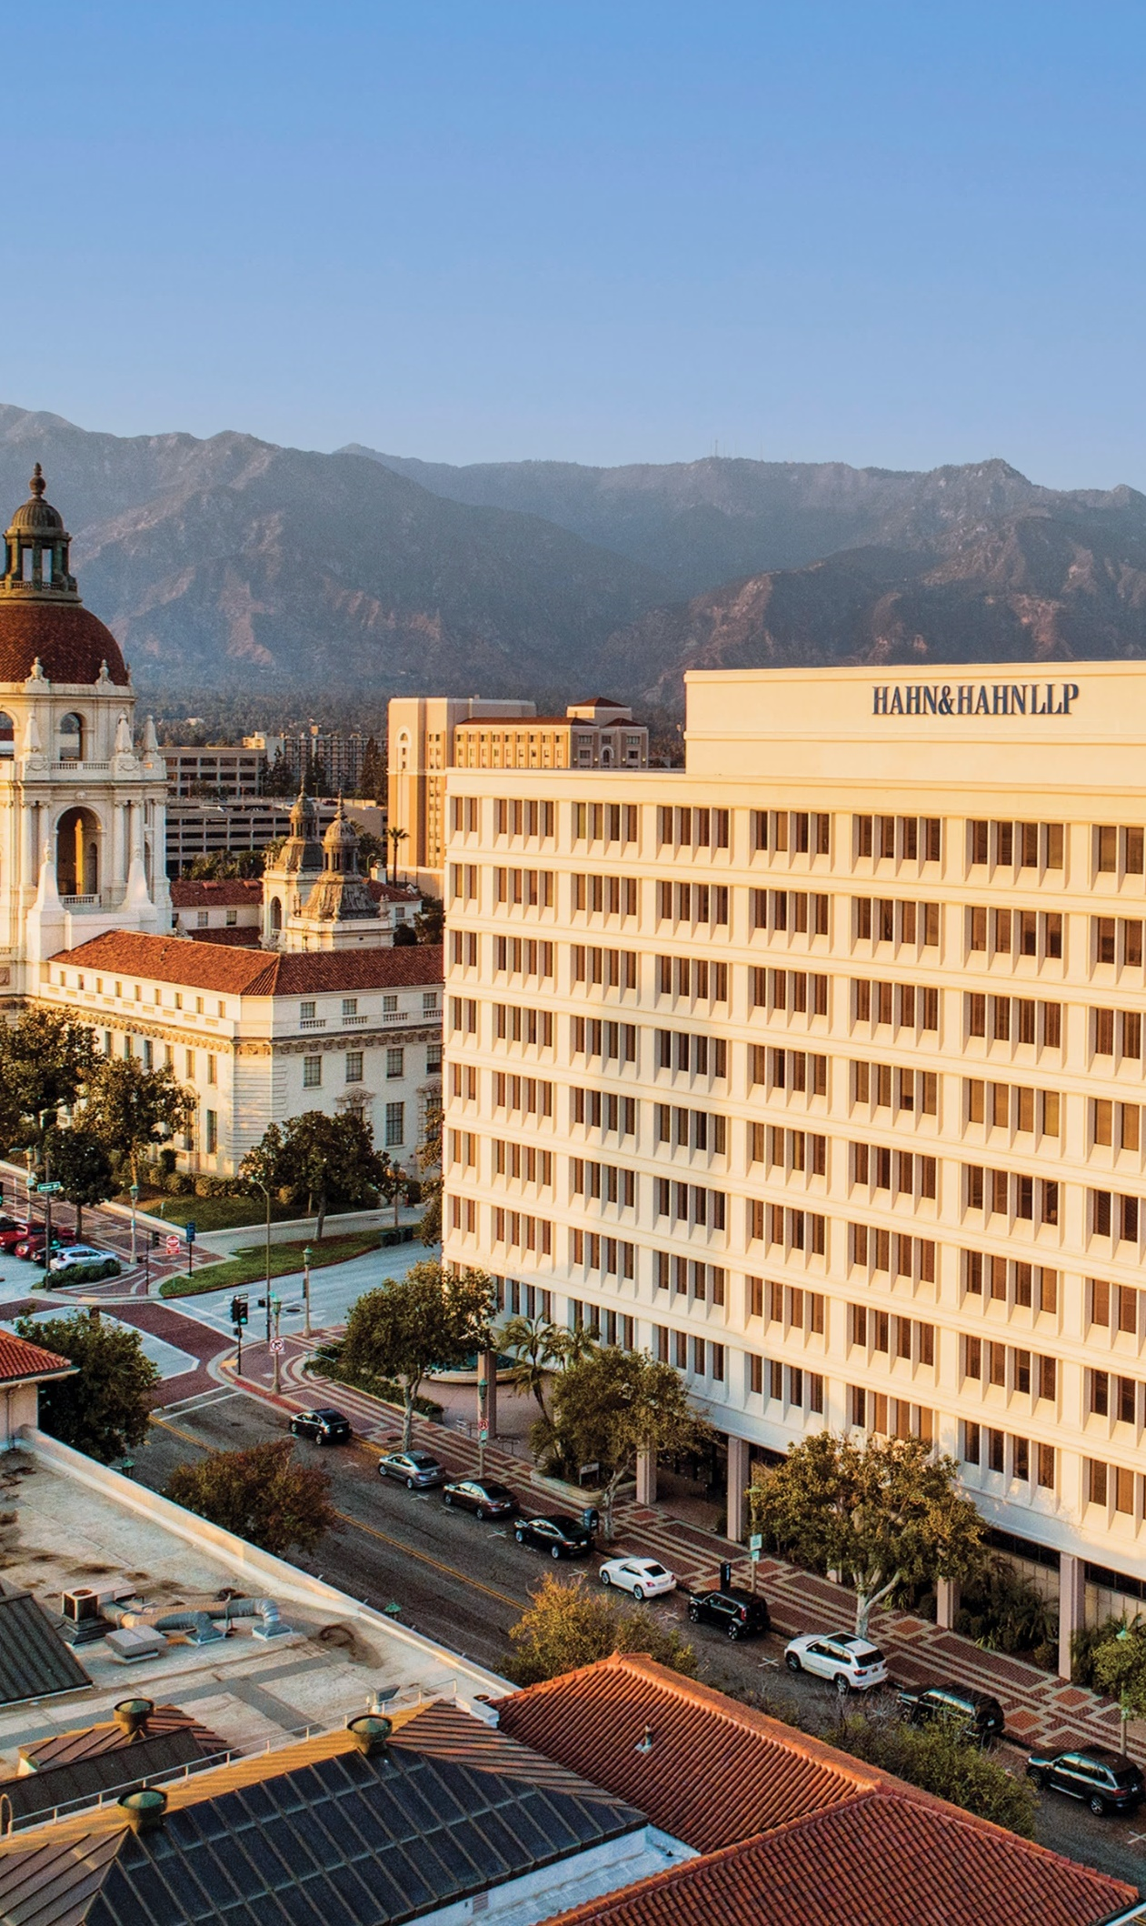
BACKGROUND
EDUCATION
CAREER

Slide 4
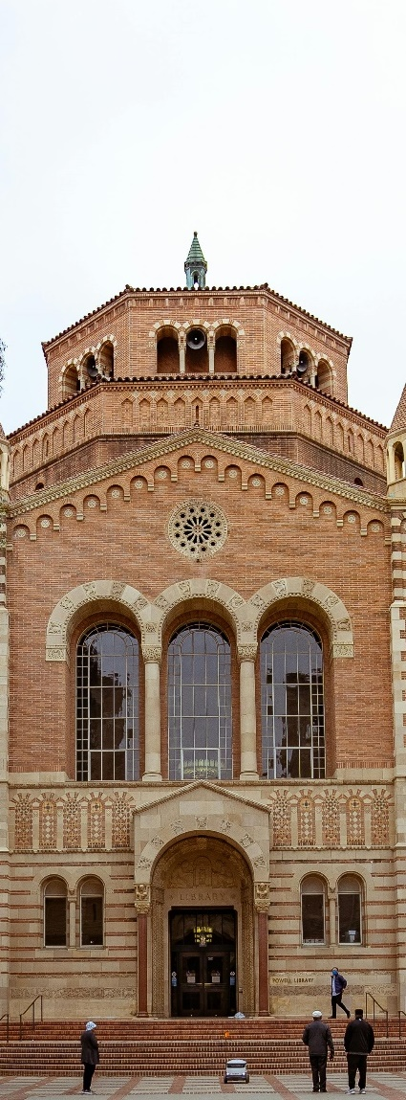
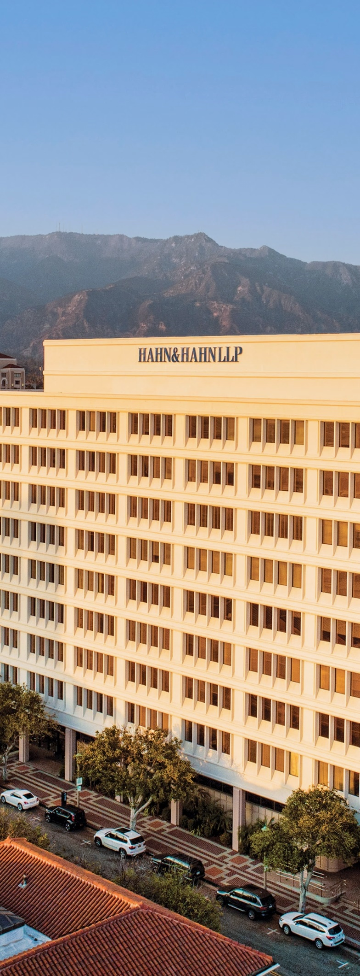
BACKGROUND
EDUCATION
CAREER

Slide 5
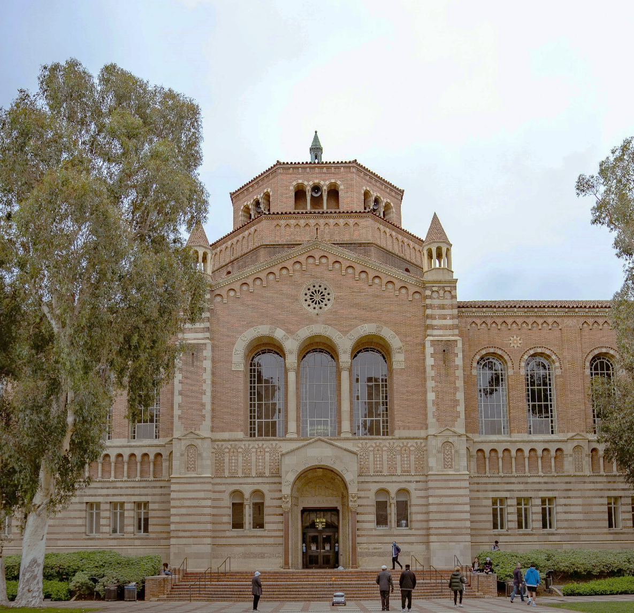
EDUCATION
BACKGROUND
CAREER

Slide 6
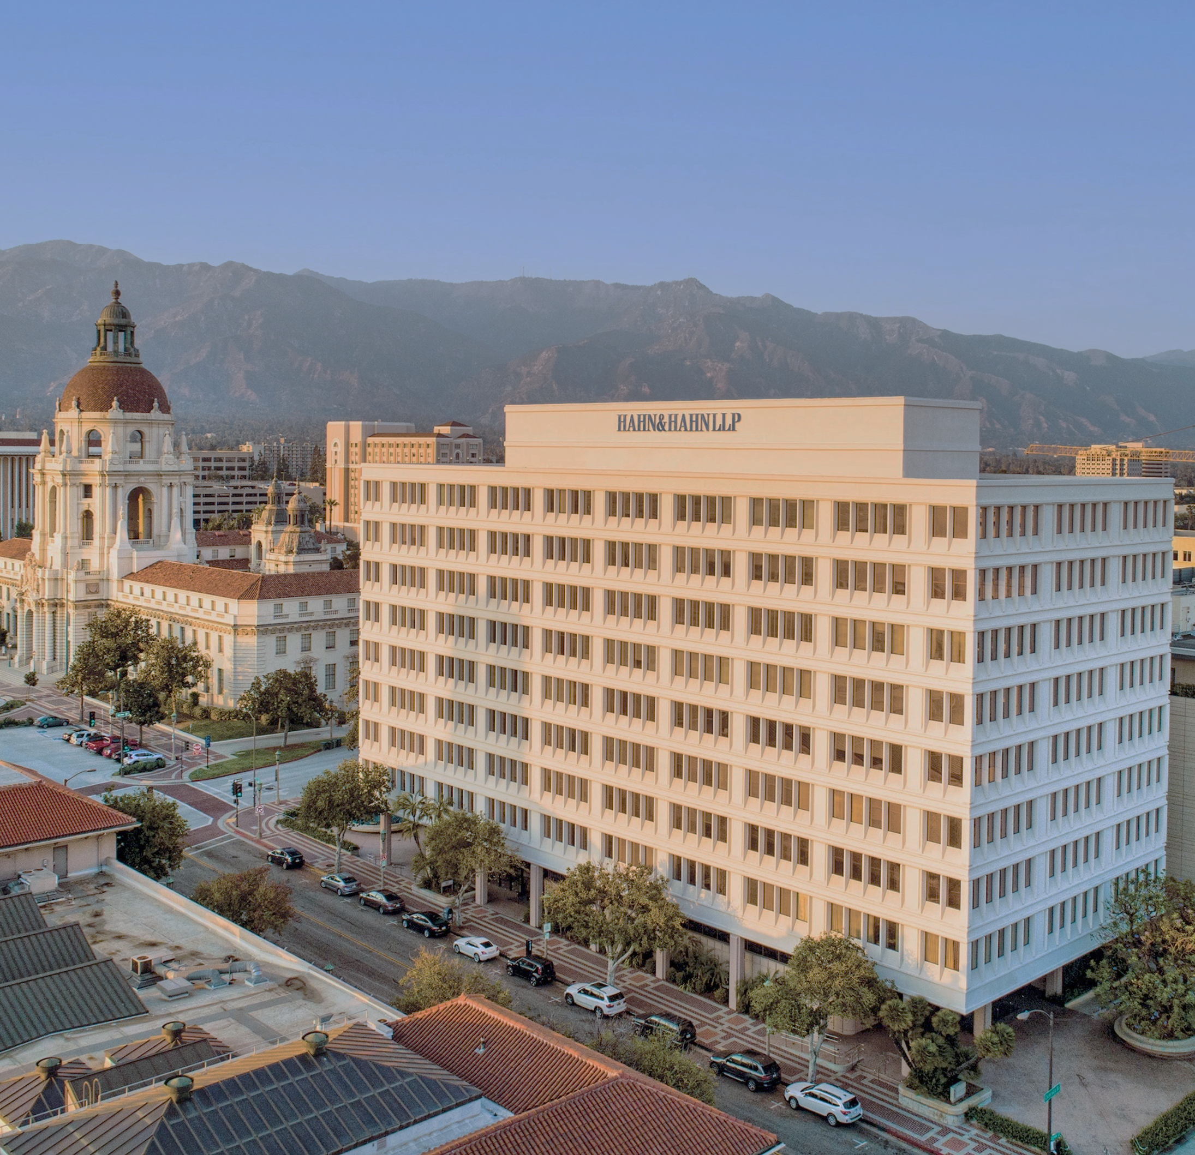
CAREER
Dewey Ballantine, Los Angeles, CA (1990-1992)
Hahn & Hahn LLP, Pasadena, CA (1992-Present) | Partner
Employment law; commercial and tort litigation
BACKGROUND
EDUCATION

Slide 7
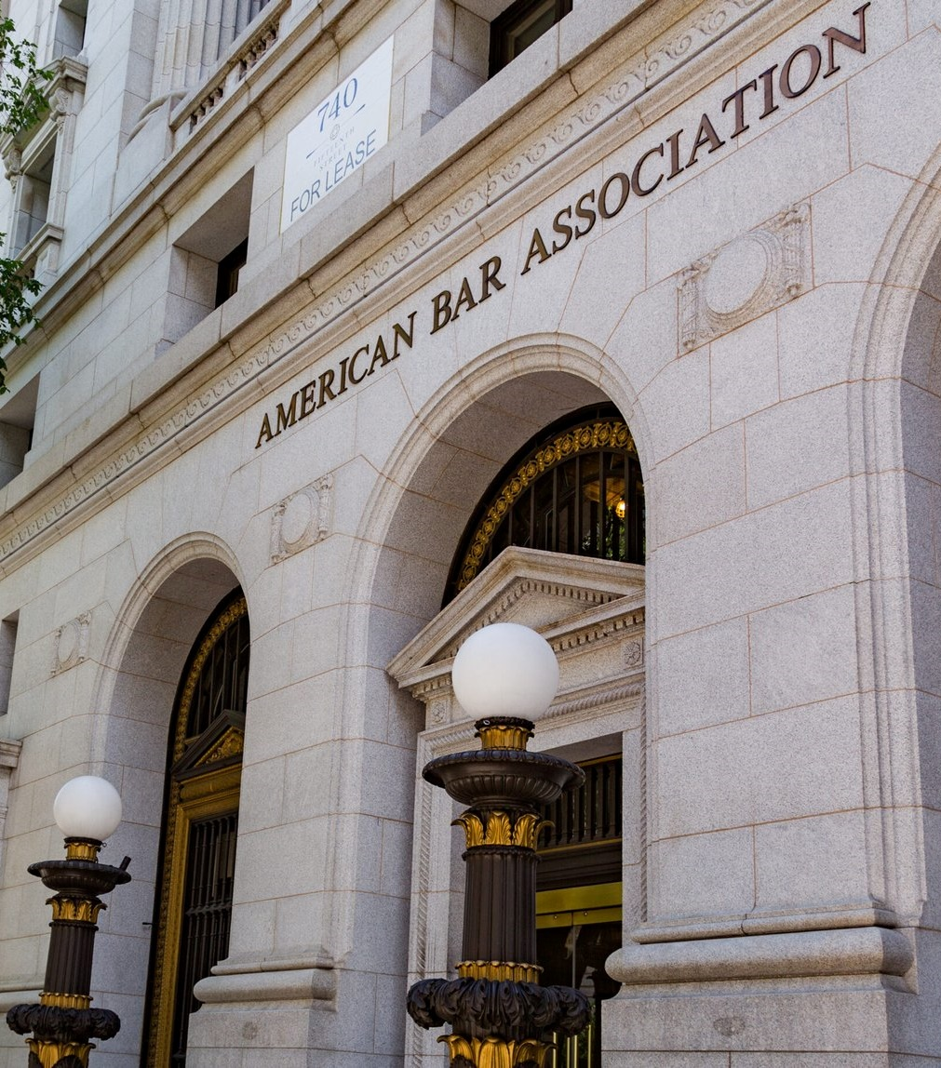
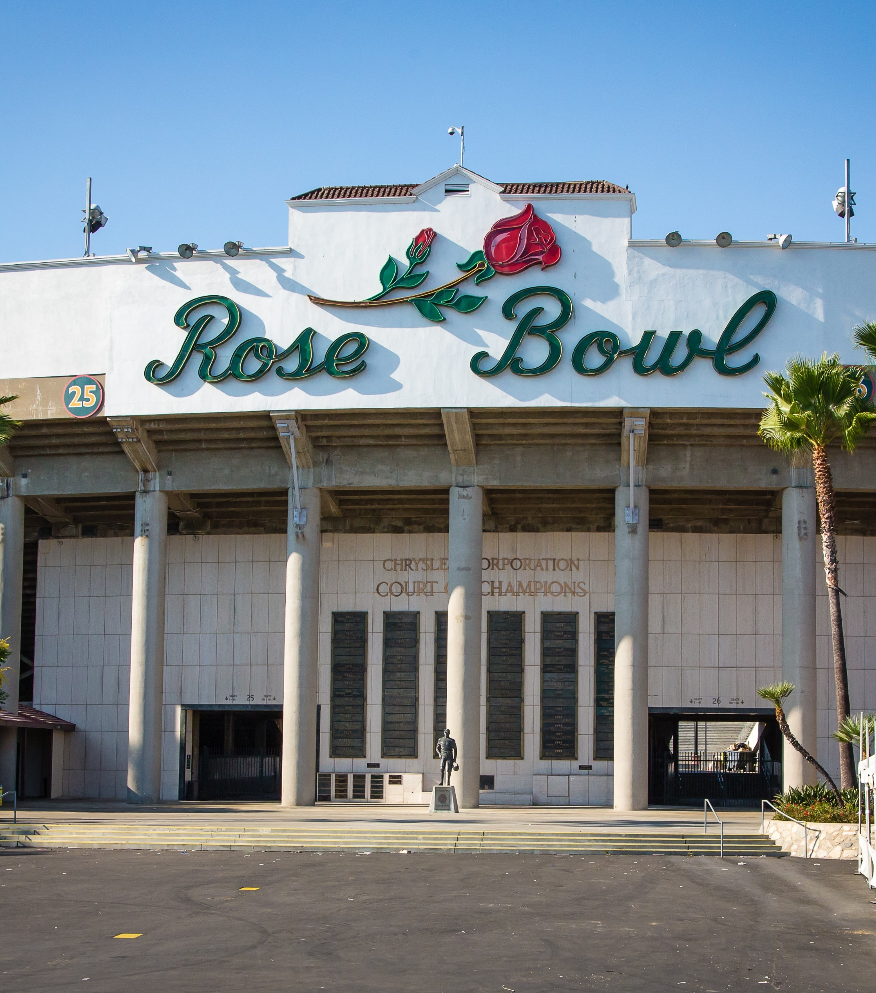
ABA ACTIVITIES
PROFESSIONAL ACTIVITIES

Slide 8
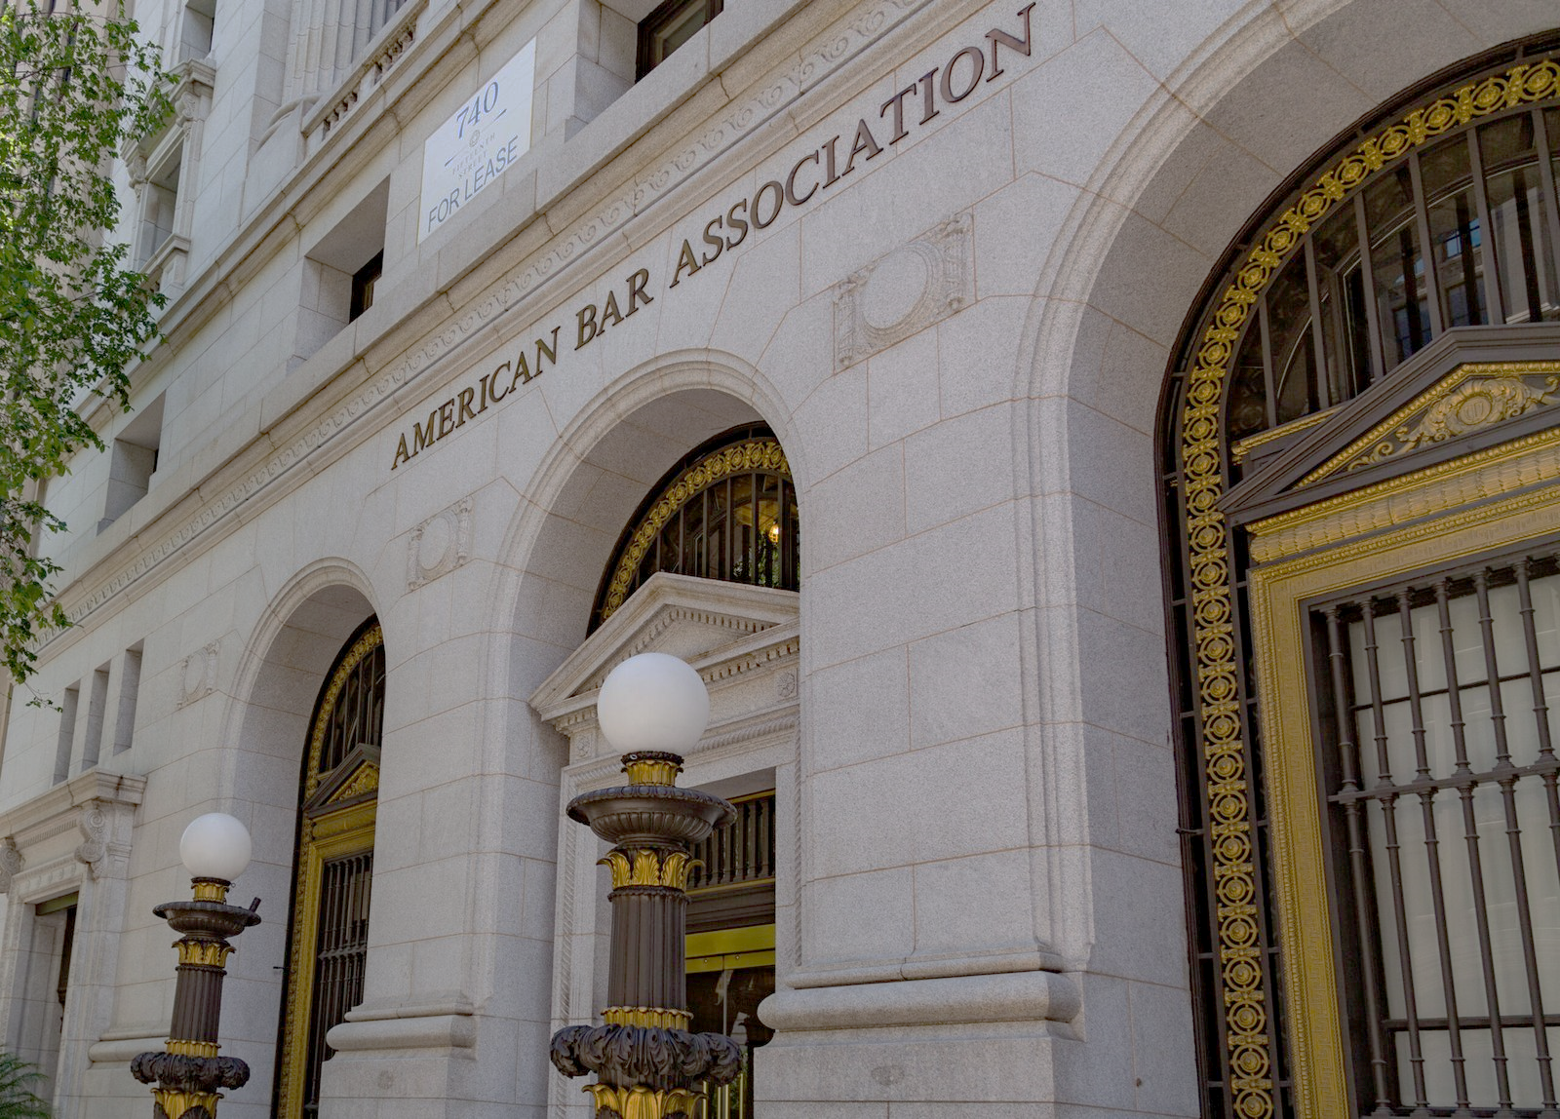
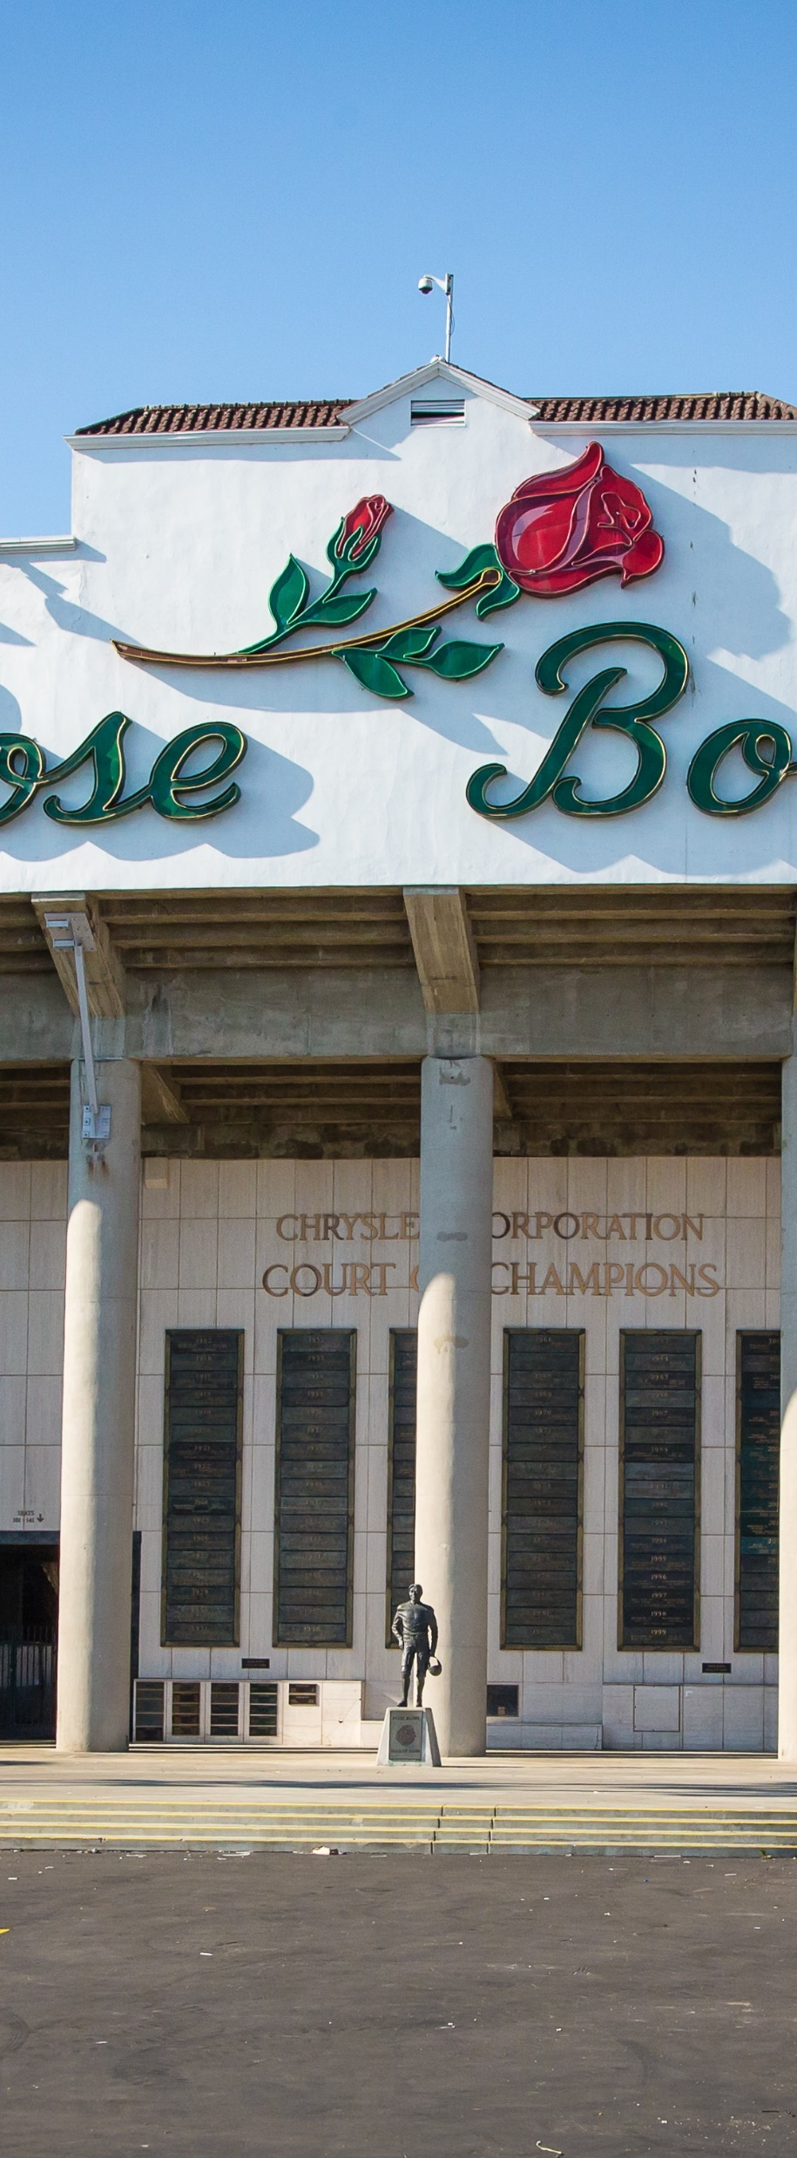
ABA ACTIVITIES
American Bar Foundation - Past Chair, Fellows (2024-2025) - Chair, Fellows (2023-2024) - Chair-Elect, Fellows (2022-2023) - Secretary, Fellows (2021-2022)
American Bar Association
Young Lawyers Division - Division Delegate to the House of Delegates (2002-2005) - Chair (2001-2002) - Chair-Elect (2000-2001) - Secretary/Treasurer (1999-2000) - Member, Cabinet (1997-1998) - Liaison, Commission on Women in the Profession (1999-2001) - Chair, Professional Development Conference (1997-1998) - Member, Long Range Planning Committee (1997-2000) - Member, Resolutions Committee (1997-1998) - District Representative, District 32, Southern California (1997-1999) - Host Committee Chair, Spring AOP (1997-1998) - Host Committee Chair, Mid-Year Meeting Los Angeles (1998-1999) - Host Committee Member, San Francisco Annual Meeting (1996-1997) - Young Lawyers Division AOP National Conferences Team Vice Chair (1996-1997) - Planning Board Member (1995 to 1999) - Women In The Profession Committee Assistant Editor, Affiliate Newsletter (1995-1996) - Public Subgrant Judge (1995-1996) - Co-Chair, Western Caucus (1995-1996) - Award of Achievement Newsletter Competition Judge (1996)
Tort Trial and Insurance Practice Section - Chair, Law in Public Service Committee (2007-2008) - Section Officers Conference Chair, Strategic/Long Range Planning Committee (2006-2010) - Member, SOC Executive Committee (2003-present) - Liaison to Board of Governors Program & Planning Committee (2003-2005) - Chair, Nominating Committee (2002-2003)
House of Delegates - Chair, Rules and Calendar Committee (2022-2024) - Member, Rules and Calendar Committee (2016-2018) - Chair, Credentials and Admissions (2010-2012) - Vice-Chair, Credentials and Admissions (2008-2010) - Vice-Chair, Select Committee (2005-2008) - Member, Tellers Committee (2002-2004) - President-Elect Reginald Turner Jr.’s Appointments Committee, Vice-Chair (2020-2021) - President-Elect Judy Perry Martinez’s Appointments Committee (2018-2019) - President-Elect Linda Klein's Appointments Committee (2015-2016) - President-Elect Mathis’s Appointments Committee (2005-2006) - President-Elect Grey’s Appointments Committee (2003-2004) - President-Elect Archer’s Appointments Committee (2002-2003)
Fund for Justice and Education - Advisory Member FJE Council (2024-2025) - Member, Council (2002-2003)
Multi-Cultural Women Attorneys Network - Member (2007-present)
Commission on Renaissance of Idealism in the Profession - Member (2005-2006)
Commission on Youth At Risk - Member, Advisory Committee (2011-2012) - Chair (2009-2011) - Vice-Chair (2006-2009)
Commission on Domestic Violence - Chair, Pro Bono Committee (2005-2008) - Member (2005-2008)
ABA Journal - Member, Board of Editors (2006-2012)
General Practice Solo Small Firm Division - Chair (2011-2012) - Chair-Elect (2010-2011) - Vice-Chair (2009-2010) - Secretary (2008-2009) - Chair, Bylaws Committee (2008-2009) - Member Budget Committee (2008-2009) - Division One Director (2006-2008) - Member, Council (2003-2007) - Member, Tactical Planning Committee (2005) - Chair, SWAT Team (2005-2006) - Chair, Diversity Committee (2003-2004) - Chair, Public Service Committee (2002-2004) - Member, Nominating Committee (2003-2004) - Diversity Fellow (2002-2003)
- Member, ABA Day Planning Committee (2024-present) - Member, 250th Anniversary of the Declaration of Independence Celebration Committee (2024-2026) - Member, Strategic Planning Committee (2023-2024) - Member, Co-Chair Coordinating Group on Practice Forward (April 2020 to 2022) - Chair, Latin America and Caribbean Initiative Council (2016 to August 2020) - Board Member, Rule of Law Initiative (2016 to August 2020) - California State Delegate to the House of Delegates (2015-present) - Member, ABA Executive Committee (2014-2015) - Chair, Board of Governors Program, Evaluation and Planning Committee (2014-2015) - Member, Board of Governors representing the District of California (2012-2015) - Liaison to Governance Commission from Board of Governors (2013-2015) - Member, Nominating Committee (2004-2007) - Governance Commission (2003-2005)
PROFESSIONAL ACTIVITIES

Slide 9
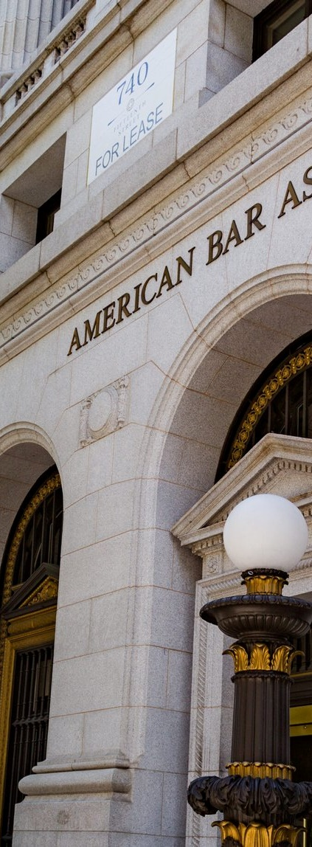
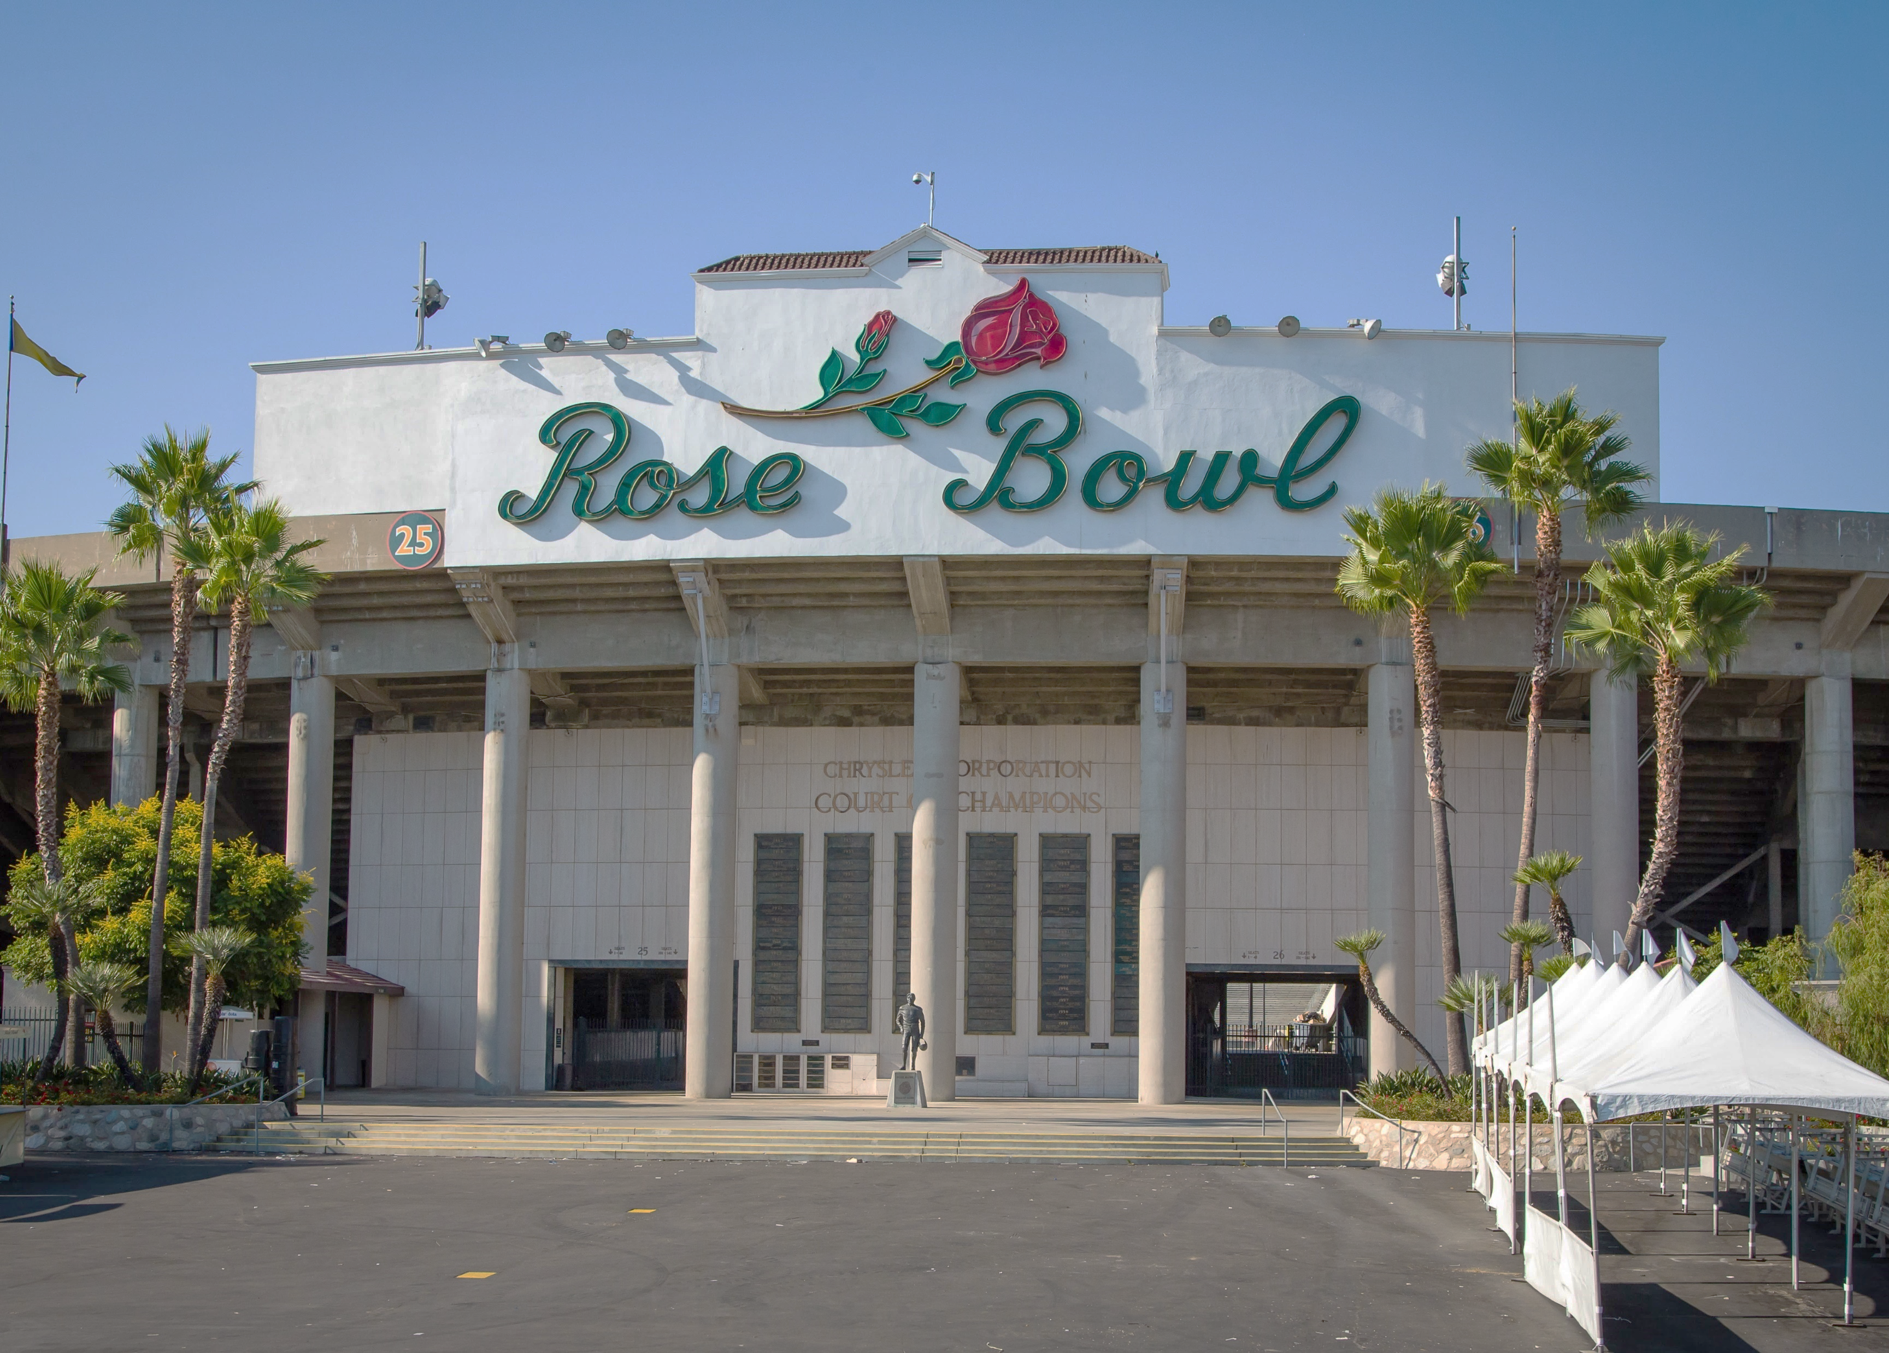
PROFESSIONAL ACTIVITIES
Los Angeles County Bar Association - LACBA Representative to the ABA House of Delegates (2005-2012) - Co-Chair LACBA 9/11 Outreach Committee for Dialogue on Freedom (2002-2003)
Los Angeles County Bar Association Barristers - Member, Membership Task Force (1997-1998) - President (1996-1997) - President-Elect (1995-1996) - Vice President (1994-1995) - Executive Committee (1992-1994) - Chair, Bias in the Legal Profession Committee (1994-1995) - Education Committee (1991-1992) - Strategic Planning Committee (1992) - Chair, Bench and Bar Relations Committee (1992-1994) - Trustee, LACBA Board of Trustees (1995-1997) - Member, Litigation Section Inns of Court (1992-1996) - Member, LACBA Nominating Committee (1994-1995) - Member, Minorities in the Legal Profession Committee (1994-present)
State Bar of California - Member, Litigation Section
Women Lawyers Association of Los Angeles - Member
California Women Lawyers - Member
National Association of Women Lawyers - Member
Mexican American Bar Association - Member
Latina Lawyers Bar Association - Member
Hispanic National Bar Association - Member
American Law Institute - Member
Clazzical Notes Board of Directors (2016-present)
YWCA Board of Directors (1997- 2001) Chair, Public Policy Committee (1998-2001) Vice President, Public Policy (2000-2001)
Pasadena Educational Foundation Business Committee (1995-1996)
South Pasadena School District Marengo Elementary School Site Council Fourth Grade Class Representative (2008-2009) Fifth Grade Class Representative (2007-2008)
South Pasadena Middle School Booster Club Bylaws and Parliamentarian Officer (2011-2012)
Pasadena Tournament of Roses Association - Rose Bowl Management Committee Chair (2020-2025) - Past President (2022–present) - Immediate Past President (2020-2021) - President (2019-2020 presided over the 2020 Rose Parade and Rose Bowl Game) - Executive Vice President (2018) - Treasurer (2017) - Secretary (2016) - Executive Committee Vice President (2012-2015) - Chairperson, Formation Area Committee (2010-2012) - Director (2011 to present) - Member, Membership Committee (2011-2012) - Chairperson, Judging Committee (2008-2010) - Chairperson, Decorating Places Committee (2006-2008) - Member, Governance Steering Committee (2006-present) - Chairperson, Membership Development Committee (2004-2006) - Vice-Chair, Fanfest Committee (2002-2004) - Member, Executive Committee (2000-2002) - Member (1994-present)
ABA ACTIVITIES

Slide 10
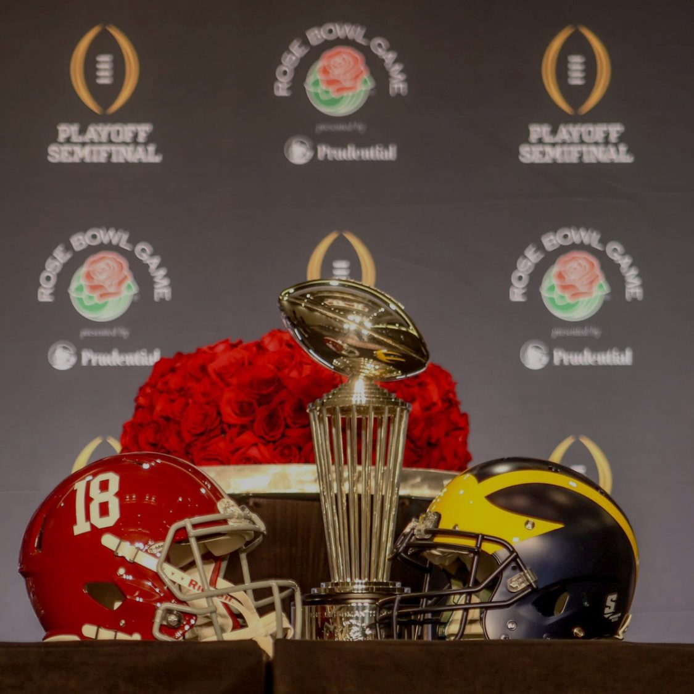
Experience in Leading with Existential Challenges
Rose Bowl Game

Slide 11
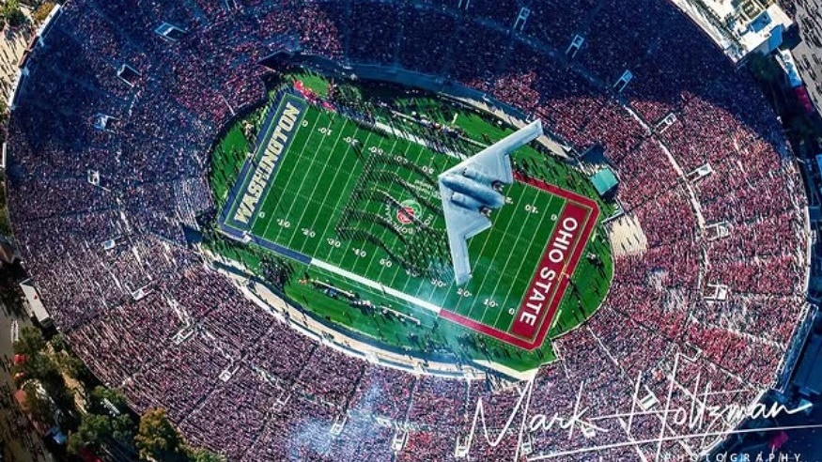
Negotiation of College Football Playoff Expansion

Slide 12
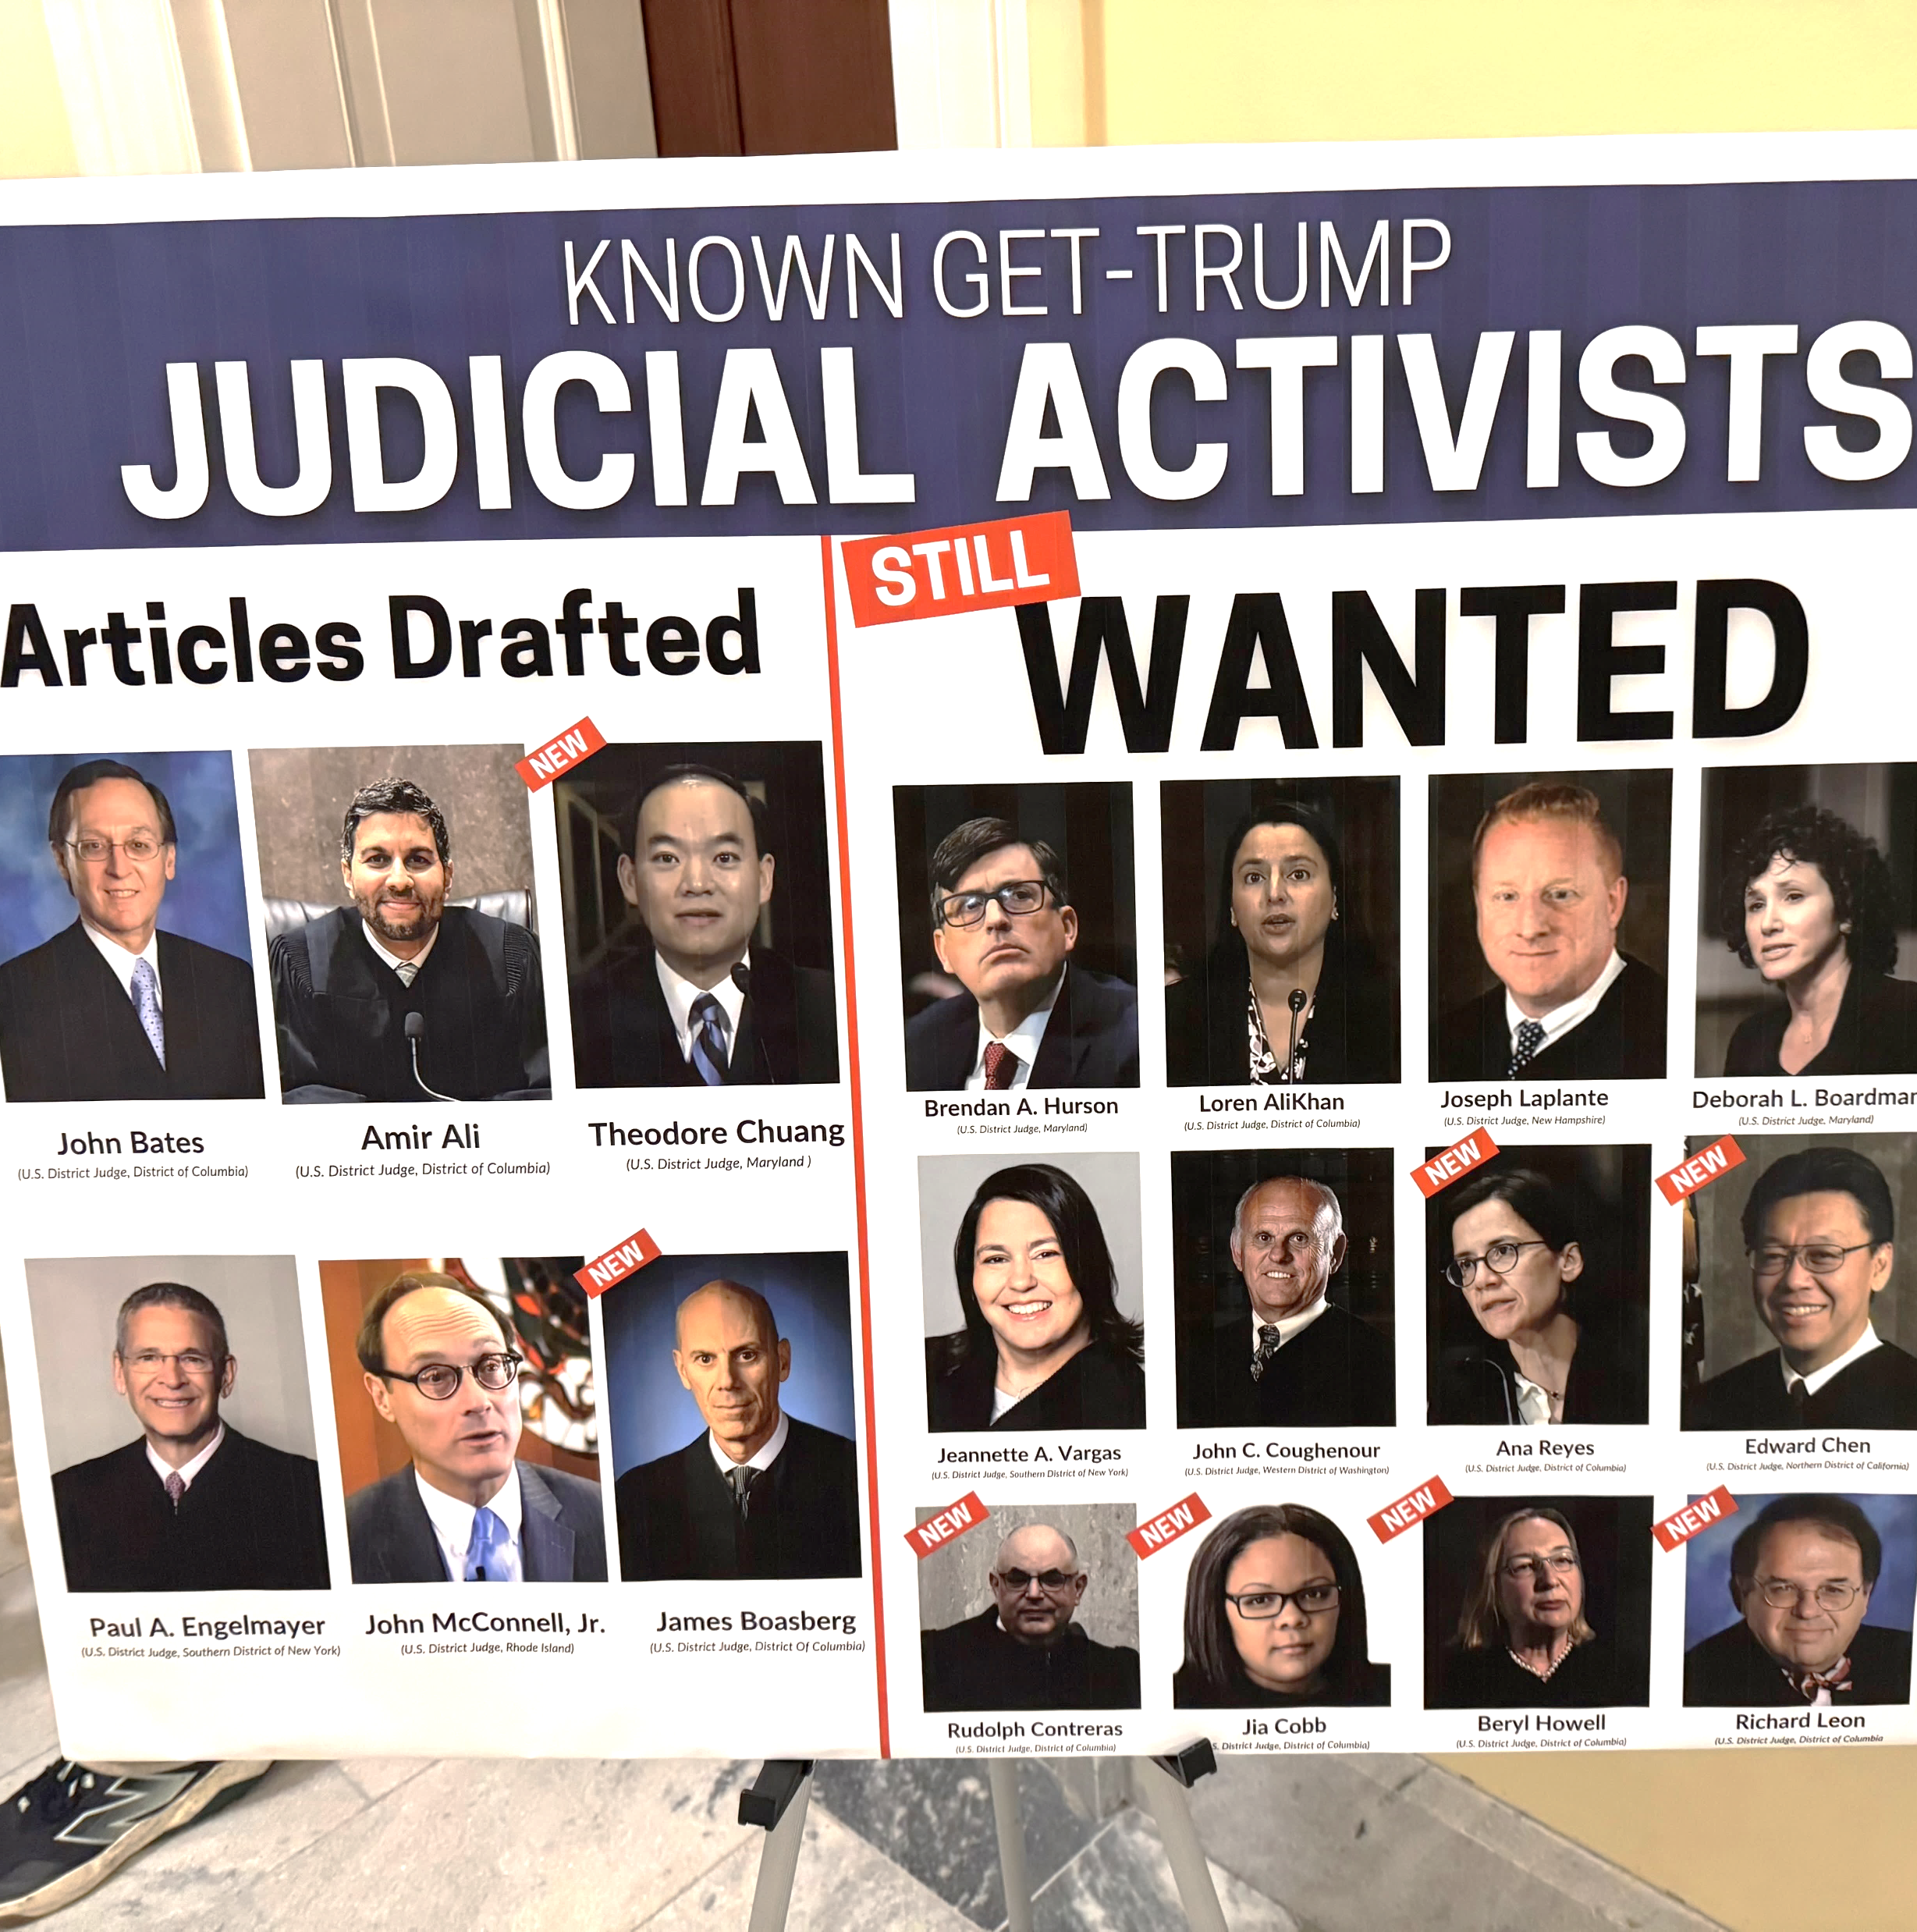
Constitutional Crisis
What’s Happening Now

Slide 13
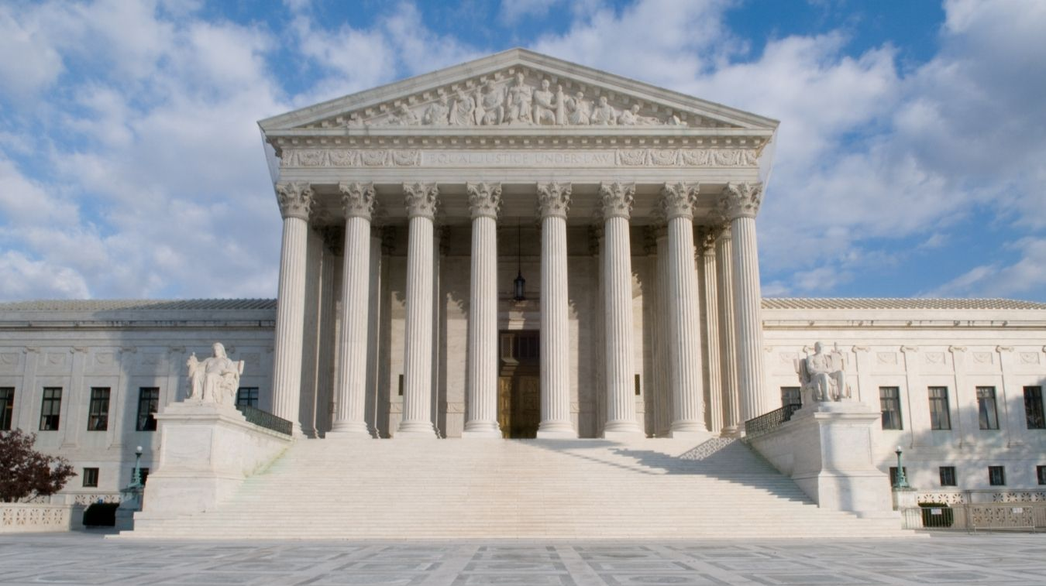
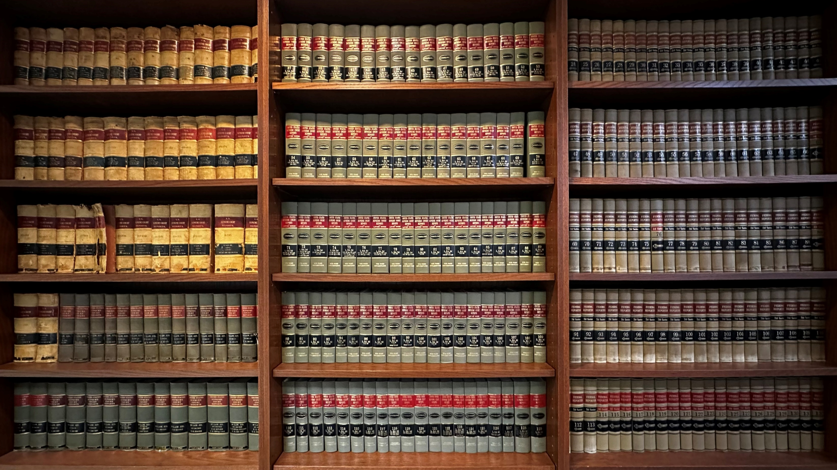

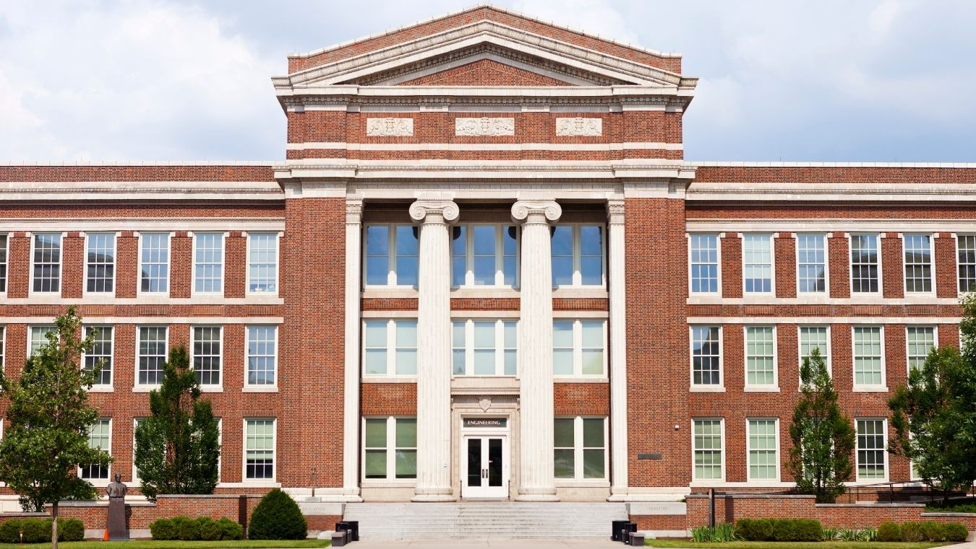
JUDICIAL BRANCH
LAW FIRMS
UNDER ATTACK
HUMAN RIGHTS
UNIVERSITIES

Slide 14
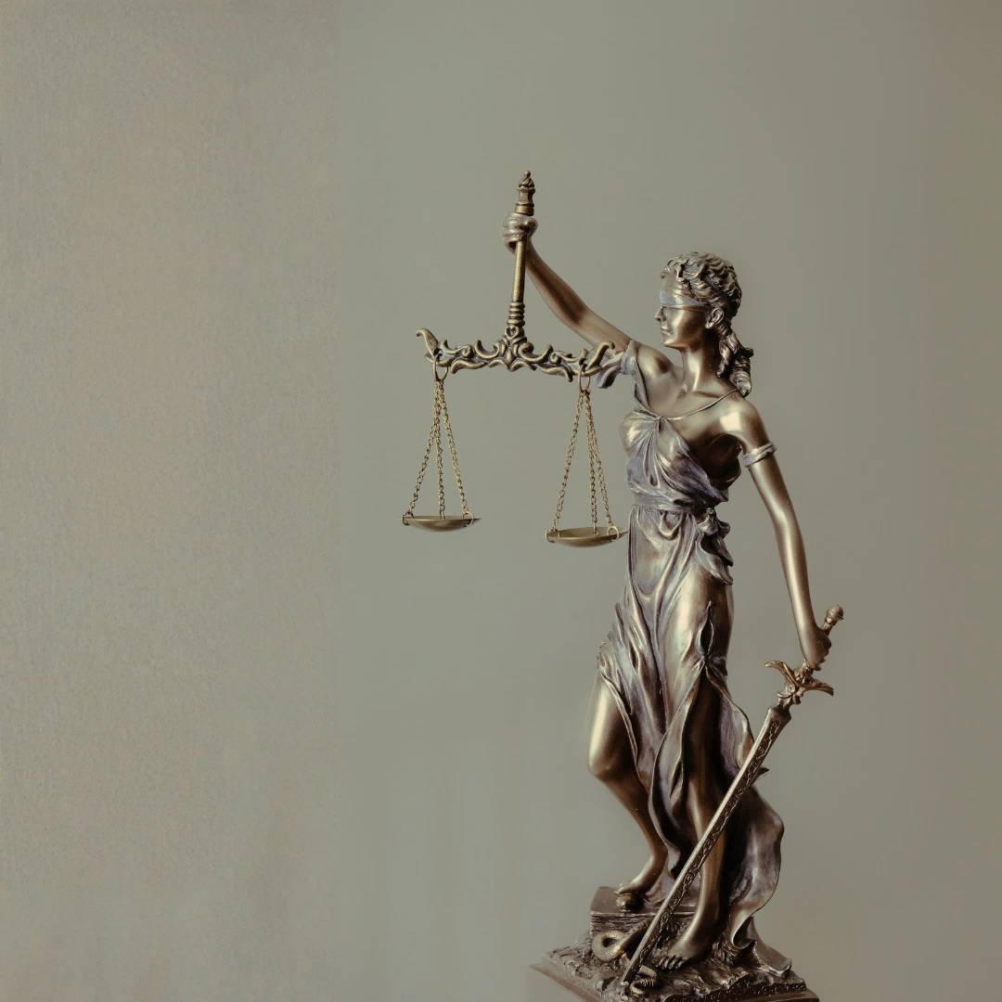
Attacks on the Rule of Law
Why does this matter?

Slide 15




Why the Rule of Law Matters
World Justice Project defines “Rule of Law” as:
Foundational principle for our democracy and our country
Accountability
Just Law
Open Government
Accessible and Impartial Justice
Country ruled by enacted laws, not by the whims of men and women
Laws apply equally to all people and institutions, ensuring fairness, justice, and stability in society.
“No one is above the law, and everyone is accountable under it.”

Slide 16
ABA Mission and Goals
Mission
To serve equally our members, our profession and the public by defending liberty and delivering justice as the national representative of the legal profession
The ABA achieves its mission through tireless work toward four Goals.
I. SERVE OUR MEMBERS
IV. ADVANCE THE RULE OF LAW
Provide benefits, programs and services which promote members’ professional growth and quality of life.
Increase public understanding of and respect for the rule of law, the legal process, and the role of the legal profession at home and throughout the world.
Hold governments accountable under law.
Work for just laws, including human rights, and a fair legal process.
Assure meaningful access to justice for all persons.
Preserve the independence of the legal profession and the judiciary.
II. IMPROVE OUR PROFESSION
Promote the highest quality legal education.
Promote competence, ethical conduct and professionalism.
Promote pro bono and public service by the legal profession.
III. ELIMINATE BIAS AND ENHANCE DIVERSITY
Promote full and equal participation in the association, our profession, and the justice system by all persons.
Eliminate bias in the legal profession and the justice system.

Slide 17
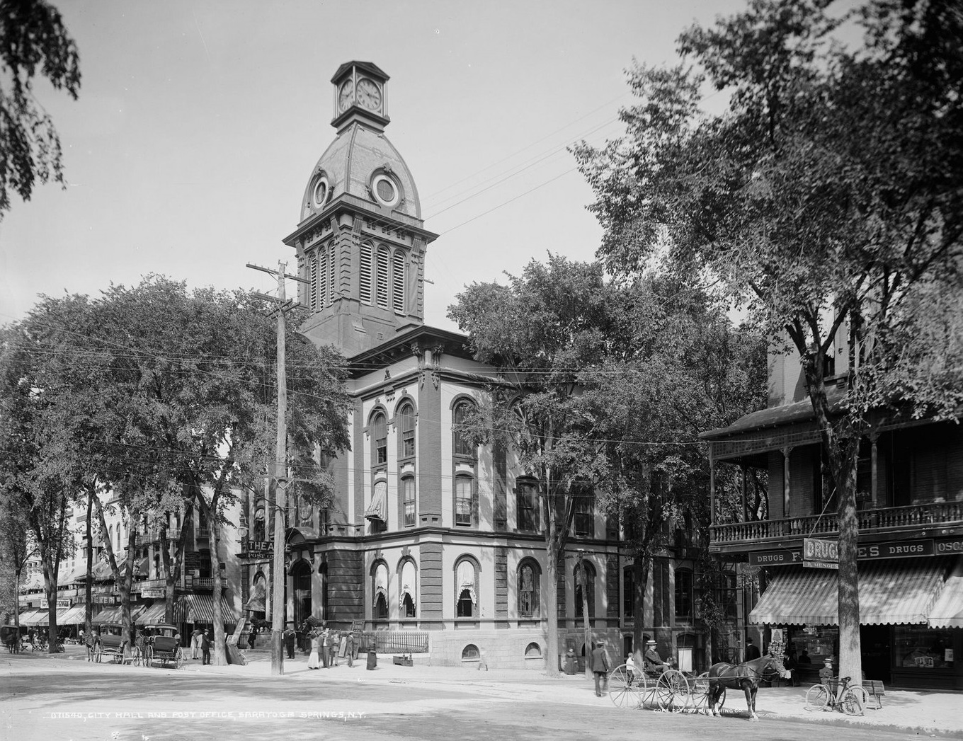
150th Anniversary
AUGUST 21, 1878: 75 lawyers from 20 states and the District of Columbia met in the town hall courtroom in Saratoga Springs, New York, to establish the American Bar Association.

Slide 18
Empowering Our Organizations
Growth and Collaboration

Slide 19










Strategies
Collaboration with state and local bar associations
Mobilizing membership
Non-partisan principles
Future of the profession
Resources
- Civics education
- “Rule of Law” Toolkit
Outreach to and engagement with
Seeking opportunities to speak with non-lawyers
Young lawyers
Neighbors, family, community members
Law students
How this impacts them

Slide 20






Questions
Contact
626.796.9123
PHONE
lfarber@hahnlawyers.com
EMAIL
https://hahnlawyers.com/laura-v-farber
WEBSITE
https://www.linkedin.com/in/LauraFarber1
LINKEDIN

