Slide 1
Emerging Legal Trends & What it Means for Bar Leaders
Chris Newbold, ALPS
November 8, 2025
New England Bar Association
Portsmouth, New Hampshire
cnewbold@alpsinsurance.com

Slide 2


AGENDA
TODAY’S STATE BAR LEADERSHIP REALITIES
TRENDS OF NOTE
AI & LEGAL SERVICE DELIVERY
BUSINESS & CLIENT RELATIONS
LAWYER TRANSCIENCY
WELL-BEING TRENDS
STRATEGIC PLANNING TRENDS
LEGAL MALPRACTICE TRENDS

Slide 3

TODAY’S STATE BAR LEADERSHIP REALITIES
NAVIGATING THROUGH UNCERTAINTY & POLITICAL DIVISION
RELEVANCE CHALLENGES
MEMBER ENGAGEMENT REALITIES

Slide 4
FIVE FUNCTIONS OF STATE BARS
INFORMATION PROVIDER
NETWORKING & PROFESSIONALISM
MEMBER BENEFIT PROVIDER
EDUCATION & CLE
ADVOCACY
(REGULATION / UNIFIED BARS)

Slide 5

TREND #1: AI & LEGAL SERVICE DELIVERY
Transforming Legal Workflows through Automation – Contract Review, Research, Document Drafting, Litigation Strategy
Competitive Pressures
Predictive & Legal Analytics
A Notable State Bar Opportunity

Slide 6

TREND #2: LAW FIRM BUSINESS SHIFTS
Billable Hour & Alternative Revenue Models
Shifting Client Expectations
Talent Acquisition & Retention
Hybrid Work Impacts
A Thought on Cybersecurity Risk & Data Privacy

Slide 7
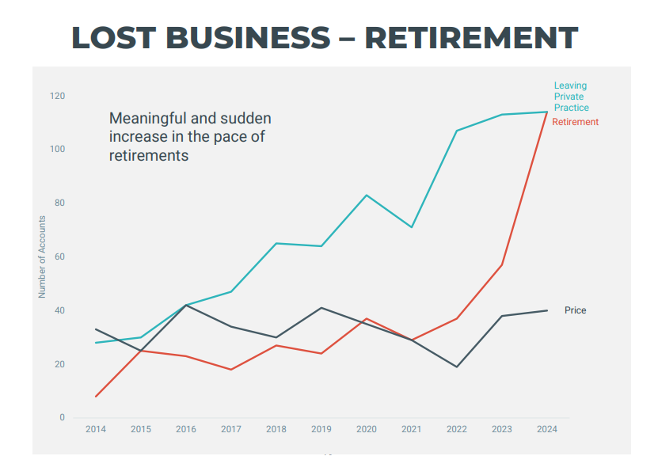
TREND #3: LAWYER TRANSCIENCY
Greatest Period of Lawyer Transiency Ever?
The Silver Tsunami Has Arrived
Realities of Private Practice
Women Leaving Legal
Associate Movement
Career Shifts to JD+ Paths
Lack of Professional Satisfaction
Notes:
92% of New Business was firm size 1 or 2

Slide 8
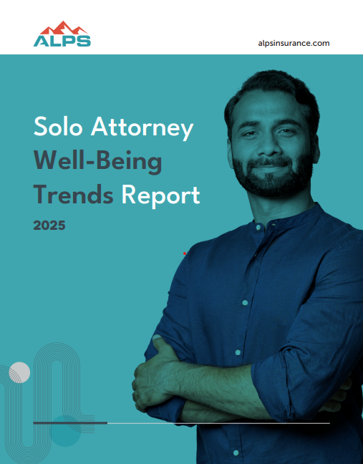

TREND #3: SOLO AND SMALL FIRM SPACE
Prediction: Consolidation Up or Disaggregation Down? Smart $ on the Latter
“What Kind of Life Do I Want to Live?”
Tech Tools: Leveling the Playing Field
Flexibility Prioritization
Remote / Virtual Work Possibilities

Slide 9
1.3m Lawyers
35% Off the Top: Private Practitioners (845k)
49% Solos (415k)
Next Largest – Firms 2-5 - 14% (120k)
Strategic Opportunity for Bars
TREND #3:
SOLO AND SMALL FIRM SPACE – INSIDE THE NUMBERS
535k in Market Opportunity
535k in Market Opportunity

Slide 10

TREND #4: WELL-BEING TRENDS
Societal Embrace of Mental Health
Generational Shifts / Expectations of Work-Life Balance
Technology Anxiety
Isolation & Remote Work

Slide 11
TREND #5: STRATEGIC PLANNING TRENDS
Concentrated Focus on Member Needs / Creating Member Value
Desire for Greater Data Analytics
Differentiated Thinking on Engagement & Community
Pace of Change Opportunity
A Thought on Legal Deserts

Slide 12
TREND #6: LEGAL MALPRACTICE TRENDS
FREQUENCY HOLDING STEADY – SEVERITY CONCERNS (INSURANCE DEFENSE)
MACROECONOMIC REALITIES
TRUST & ESTATE EXPOSURE
SOLOS GOING WITHOUT MALPRACTICE INSURANCE
“QUALITY OF LAWYERING” CONCERN

Slide 13
Q & A

