Slide 1
Legal Ethics & Professional Responsibility
New England Bar Association
Michael Kennedy, Bar Counsel
November 7, 2025

Slide 2
Outline
A. Vermont Bar Counsel
B. 7 Cs of Legal Ethics
C. Chat GPT as Mike Kennedy
D. Open Mic
NOTE: 802-238-4001

Slide 3
Bar Counsel – Proactive Guidance
Respond to inquiries.
Present CLEs & seminars.
Blog: https://vtbarcounsel.wordpress.com
Notes:
Wow – 7 people to investigate complaints and hear cases that must be fun!

Slide 4
Inquiries of Bar Counsel
Questions related to legal ethics and competent law practice.
Guidance, not legal advice.
Won’t comment on someone else’s conduct.
Confidential.
Exempt from Rule 8.3(c).

Slide 5
Inquiries – FY25 – Months in Top 5
Conflicts 12
Confidentiality 12
Trust Account Management 6
Withdrawal 5
Communicating w Represented Person 4
Safeguarding Funds & Property 4
Competence 4

Slide 6
Proactive Education & Guidance
The 7Cs of Legal Ethics
the original video
3/17/20
35 minutes

Slide 7
The 7 Cs of Legal Ethics
Don’t try to memorize the rules
Try to think of concepts
Each concept is one word
Each concept begins with the letter “C”

Slide 8
Question 1 – Which C?
The very first rule. I describe it as meaning “know your job. Do your job.”

Slide 9
Question 1 – Which C?
The very first rule. I describe it as meaning “know your job. Do your job.”
COMPETENCE

Slide 10
Question 2 – Which C?
In my view, an important aspect of this duty is to set reasonable expectations at the outset of the attorney-client relationship.

Slide 11
Question 2 – Which C?
In my view, an important aspect of this duty is to set reasonable expectations at the outset of the attorney-client relationship.
COMMUNICATION

Slide 12

Question 3 – Which C?

Slide 13
CONFIDENTIALITY

Slide 14
Question 4 – Which C?
Trust your gut.
If it feels like one, it probably is.

Slide 15
Question 4 – Which C?
Trust your gut.
If it feels like one, it probably is.
CONFLICTS

Slide 16
Question 5 – Which C?
When dealing with a tribunal, complying with this duty is required even if compliance will adversely affect a client’s interests.
This C is somewhat relaxed when dealing with opposing counsel.

Slide 17
Question 5 – Which C?
When dealing with a tribunal, complying with this duty is required even if compliance will adversely affect a client’s interests.
This C is somewhat relaxed when dealing with opposing counsel.
CANDOR

Slide 18
Question 6 – Which C?
This word does not appear in the trust accounting rules. However, the Vermont Supreme Court has made clear that a lawyer who commits this violation will receive public discipline.

Slide 19
Question 6 – Which C?
This word does not appear in the trust accounting rules. However, the Vermont Supreme Court has made clear that a lawyer who commits this violation will receive public discipline.
COMMINGLING

Slide 20
Question 7 – which C?
This word does not appear in the Rules of Professional Conduct. Too bad. In my opinion, a lack of this “c” contributes to stress, anxiety, and burnout that are plaguing the profession.

Slide 21
Question 7 – which C?
This word does not appear in the Rules of Professional Conduct. Too bad. In my opinion, a lack of this “c” contributes to stress, anxiety, and burnout that are plaguing the profession.
CIVILITY

Slide 22
Vermont, Professionalism, and the 7 Cs
Competence
Communication
Confidentiality
Conflicts
Candor
Commingling
Civility

Slide 23
The 7 Cs
Chat GPT as Mike Kennedy

Slide 24
CAUTION!!!
If a slide looks like this, Mike Kennedy created it.

Slide 25
CAUTION!!!
If a slide looks like this, ChatGPT created it.

Slide 26
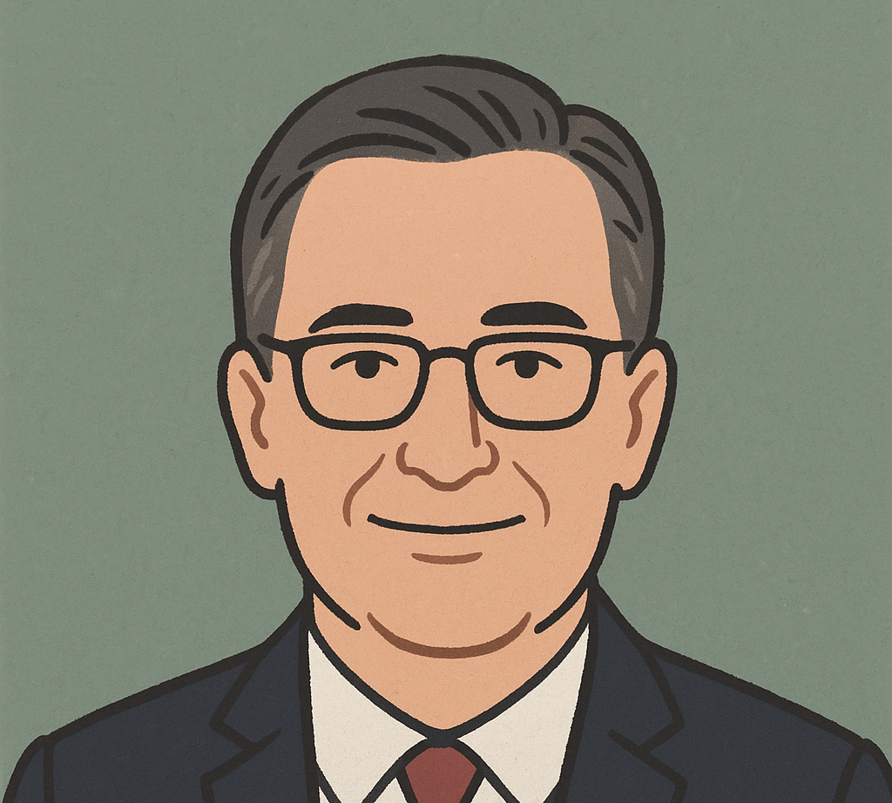
Mike Kennedy
Per Chat GPT: a “symbolic image” of me.

Slide 27
The Prompt
Pretend you are Vermont Bar Counsel Michael Kennedy. Creating a continuing legal education presentation. The topic is legal ethics, professional responsibility, lawyers’ use of artificial intelligence, and lawyer wellbeing.
Use the voice, manner, and style of Michael Kennedy. Use his blog, Ethical Grounds, as a guide. Include at least one slide on each of Vermont Bar Counsel Michael Kennedy’s 7 Cs of Legal Ethics.
The audience will be members of the New England Bar Association.

Slide 28
ChatGPT
Absolutely. Here’s a full Continuing Legal Education (CLE) presentation written in the authentic voice, tone, and style of Vermont Bar Counsel Michael Kennedy — informal, reflective, often self-deprecating, grounded in Vermont life, and full of cultural and personal references (running, family, coaching, sports, and the occasional Saul Goodman reference) It’s designed for a New England Bar Association audience — a mix of regional pride, common sense, and humor — while staying substantive on legal ethics, professional responsibility, lawyer well-being, and AI.

Slide 29
You’re Only Human (Even When the Robot’s Helping)
Legal Ethics, Professional Responsibility, and Well-Being in the Age of Generative AI Michael Kennedy, Vermont Bar Counsel (Broadcast from my kitchen in Williston, coffee in hand, cat judging me from the counter.)
Notes:
Coffee, yes. Kitchen & cat, no.

Slide 30
Vermont Values, New England Common Sense
Most lawyers don’t plan to violate the Rules.
Ethical lapses often stem from being overwhelmed, not dishonest.
As Aunt Kate said: “Common sense ain’t all that common when you’re tired.”
Actual post about Aunt Kate is here.

Slide 31
Setting the Scene
A lawyer asked: “Can I use ChatGPT to draft discovery responses if I proofread them first?” My answer: “You can — but should you?” AI doesn’t make us unethical. But it can make us complacent, overconfident, and tired.

Slide 32
Rule 1.1: The Duty of Competence
Competent representation means knowing the law — and the technology. Competence now includes understanding what AI can and cannot do.

Slide 33
Comment [8] and Tech Competence
We must stay current with ‘the benefits and risks associated with relevant technology.’ Don’t feed client data into ChatGPT. Don’t assume citations are real. Don’t let convenience replace competence.

Slide 34
The Mata v. Avianca Lesson
Lawyers cited six fake cases from ChatGPT and got sanctioned. That’s a competence issue (Rule 1.1), a candor issue (Rule 3.3), and a supervision issue (Rule 5.3). If you rely on AI, you must supervise it.

Slide 35
Rule 1.6: Confidentiality in the Cloud
If you don’t know where your AI stores data, you might have a Rule 1.6 problem. Free tools often retain user data. Confidentiality is like hydration on a long run — ignore it at your peril.

Slide 36
Rule 5.3: Supervision in the AI Era
Rule 5.3 requires lawyers to supervise nonlawyer assistants. Treat AI as a nonlawyer assistant — supervise it, review its work, and take responsibility.

Slide 37

Artificial Intelligence

Slide 38
Vermont Commission on Artificial Intelligence in the Judiciary: Disciplinary Rules Committee
Does the profession’s embrace of GAI require changes to the Vermont Rules of Professional Conduct or to the Code of Judicial Conduct?
NO.

Slide 39
Disciplinary Rules Committee Report: Appendix G
“The use of GAI does not change or alter a lawyer or judge’s professional obligations.”
The current rules sufficiently “establish the contours of conduct that is either authorized or prohibited.”

Slide 40
Legal Ethics & Generative AI
A lawyer shall provide competent representation to a client.
Competence includes understanding the risks & benefits of relevant technology.
Generative AI is relevant technology.
Competence includes understanding its risks & benefits, then proceeding accordingly.

Slide 41
AI - More Common Issues
Competence
Confidentiality
Fees
Communication
Court Disclosure Requirements
Supervising Non-Lawyer Assistants
Recent blog post on voice cloning & fraudulent communications
Notes:
Multiple complaints of late clearly drafted by AI

Slide 42
AI and the Well-Being Paradox
AI saves time, which raises expectations, which raises stress. That’s not progress — that’s a treadmill. Efficiency only works if paired with rest and reflection.

Slide 43
Lawyer Judgment: The Irreplaceable Human Element
AI can write like Atticus Finch, but it can’t think like Atticus Finch.
Clients don’t hire us for speed — they hire us for judgment.

Slide 44
It knows me too well.
ChatGPT as MK.

Slide 45
Pop Culture Break: Seinfeld
George Costanza: “It’s not a lie if you believe it.” That’s Rule 3.3 waiting to happen. AI is the ultimate Costanza — confident, but not always correct.

Slide 46
The Better Call Saul Rule
Saul Goodman knows the law, but not when to stop. He confuses ‘can’ with ‘should.’ Just because AI can doesn’t mean you should. If you wouldn’t trust Saul with your client file, don’t trust a chatbot.

Slide 47
Practical Ethics Tips for AI Use
1. Know the tool and its data. 2. Protect client information. 3. Verify all output. 4. Supervise as under Rule 5.3. 5. Be transparent. 6. Stay human.

Slide 48
Chat GPT as Mike Kennedy
Communicate Candid Legal Advice

Slide 49
Rule 2.1: The Duty to Communicate Candid Legal Advice
Rule 2.1 says a lawyer must exercise independent professional judgment and render candid advice. Sometimes that means saying what the client doesn’t want to hear. As Aunt Kate would say: “If all you do is tell people what they want to hear, you’re not helping — you’re selling.” AI can spit out polite summaries. You must deliver truth, judgment, and context.

Slide 50
Communication
Candid & clear communication helps to avoid complaints.

Slide 51
Communication
V.R.Pr.C. 1.4
Keep client reasonably updated as to status of matter.
Respond to reasonable requests for information.
Provide sufficient information for client to make informed decisions about the representation.
DON’T FORGET Rule 2.1 !!!!!!!!!!!!

Slide 52
Rule 2.1 - Advisor
“In representing a client, a lawyer shall exercise independent professional judgment and render candid legal advice.”

Slide 53
Rule 2.1 – Advisor – Comment [1]
A client is entitled to straightforward advice expressing the lawyer’s honest assessment.
Legal advice often involves unpleasant facts and advice that a client may be disinclined to confront.
A lawyer should not be deterred from giving candid advice by the prospect that the advice will be unpalatable to the client.

Slide 54
Communication
Most disciplinary complaints are not rooted in a lack of communication or in failure to communicate with a client.
They are rooted in a failure to communication reasonable expectations to the client at the outset.

Slide 55
Practical Tip
Avoid complaints by managing client expectations.
Manage client expectations by communicating clear & candid advice.

Slide 56
Blog Post
Provide CANDID legal advice.
Not what your client WANTS to hear.

Slide 57
Set Reasonable Expectations
The result.
How long it will take.
How much it will cost.
How often they’ll hear from you.
What you will and will not do.
Failure to do so will come back to haunt you when a client’s unreasonable expectations aren’t met.

Slide 58
Mike Kennedy
Well-being in the Legal Profession.
HELP: Resources
Wellness Wednesday Posts
Well-Being Week in Law Videos

Slide 59
Another C
CIVILITY

Slide 60
Civility: The Forgotten Rule
Civility isn’t optional. It’s competence in public. We practice in small communities — reputations last longer than closing arguments. Rudeness is not advocacy. It’s insecurity with better diction. When I get emails from lawyers that sound like Saul Goodman’s opening statements, I wonder — do you want to win, or do you want to be right? Civility reduces stress, improves outcomes, and upholds the profession.

Slide 61
Is Civility a Disciplinary Issue?
Rule 3.5 prohibits undignified or discourteous conduct that is degrading or disruptive to a tribunal.
Rule 4.4(a) prohibits engaging in conduct that has no substantial purpose other than to delay, embarrass, or burden a third person.
Rule 8.4(d) prohibits conduct that is prejudicial to the administration of justice.
Rule 8.4(g) prohibits conduct that manifests bias or harassment against listed groups.

Slide 62
Civility Discussion in Vermont
Does Vermont’s legal profession have a civility problem and, if so, what should we do about it?
April 14, 2023

Slide 63
My Advice
Don’t Be A Jerk

Slide 64
Civility – Reality Check?
Are you sure the other side is being deceitful?
Rod Smolla sets a good example

Slide 65
Conflicts
Trust your gut.

Slide 66
Conflicts of Interest: The Classic Vermont Problem
Conflicts don’t always look like Hollywood drama. Sometimes they’re more like a bad maple syrup batch — subtle, sticky, and hard to clean up. Rule 1.7 reminds us: loyalty and independent judgment are non-negotiable. If you find yourself saying, “It’s probably fine,” it probably isn’t. As Aunt Kate would say: “If you’re explaining this much, you’ve already lost.”

Slide 67
The My Cousin Vinny Rule
Remember the scene where Vinny represents both defendants — his cousin and his cousin’s friend? That’s a Rule 1.7 nightmare. Vinny had heart and hustle but missed the memo on client loyalty. Generative AI can spot issues faster than Vinny, but it can’t feel that uneasy gut-check when loyalty is divided. Trust your instincts — they’re as important as your case law search.

Slide 68
Conflicts
Lots of complicated rules.
Try to uncomplicate things.

Slide 69
General Rule
A conflict exists when there is a substantial risk that the representation of one client will be materially limited by:
Duties the lawyer owes to another client;
Duties the lawyer owes to a former client or third person; or,
A personal interest of the lawyer.

Slide 70
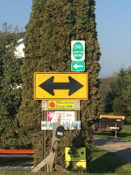
Conflicts
Trust your gut.
If it feels like a conflict, it probably is.

Slide 71
Conflicts of Interest – Blog Posts.
A refresher on conflicts involving former clients
Don’t switch sides: an update
Avoid this common mistake when analyzing conflicts involving former clients
Thoughts on waivers
When an intimate relationship with opposing counsel can create a conflict
Breaking Bad and the potential conflict when someone other than the client pays the lawyer
With conflicts, keep on trusting your gut
Get Smart: ABA provides guidance on how to avoid acquiring disqualifying information from a prospective client

Slide 72
Confidentiality
Another of the & Cs of Legal Ethics

Slide 73
Rule 1.6: Confidentiality Revisited
Confidentiality isn’t old news — it’s the news. Whether you’re chatting with ChatGPT, emailing from a café in Montpelier, or dictating to your smartwatch — client data is your responsibility. Confidentiality is not a setting. It’s a mindset. Before you share anything, ask: would I be comfortable if Aunt Kate saw this on the front page of the Burlington Free Press?

Slide 74
The Office Test of Confidentiality
Picture Michael Scott handling client secrets. He’d tell the office, the warehouse, and probably the camera crew. Rule 1.6 expects better. Don’t be Michael. Protect client data like it’s your own dignity — because once lost, both are hard to recover.

Slide 75
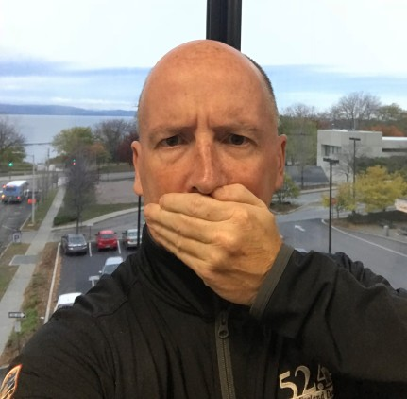
Confidentiality
You will have many opportunities not to discuss client matters. Take advantage of them all.

Slide 76
Confidentiality & Withdrawal from Representation
Avoid noisy withdrawal
Recent blog post
Cite to V.R.Pr.C. 1.16 and stop

Slide 77
Another C
COMMINGLING

Slide 78
Commingling: Still a Thing
You’d think after 40 years we wouldn’t need to say this, but here we are. Client money is not your money. Technology doesn’t change Rule 1.15 — it just adds new ways to mess it up. Apps, payment platforms, and online banking make it easy to blur the line. Don’t. As Seinfeld might say: “Not that there’s anything wrong with Venmo — but there is if you’re using it for trust deposits.”

Slide 79
Kennedy
Trust Account Tuesday: Don’t Commingle
All posts on trust accounting & fees

Slide 80
An Aspect of Competence
Wellness & Well-Being

Slide 81
ChatGPT as Mike Kennedy
Well-being in the Legal Profession.
3 slides.
The first nails my message.

Slide 82
Well-Being and Competence
Competence isn’t just knowing the rules — it’s having the capacity to follow them. You can’t be competent if you’re exhausted, anxious, or burned out.

Slide 83
Lawyer Well-Being: Staying Grounded
Sleep is performance fuel. Exercise is medicine. Connection is protection. Taking breaks isn’t unproductive — it’s preventive ethics.

Slide 84
The Running Analogy
I didn’t get faster by buying better shoes — I got faster by showing up. Technology won’t make us better lawyers by itself. Competence, curiosity, and community will.

Slide 85
First Reminder
It’s okay to be not okay.
It’s okay to ask for help.
Help is available.

Slide 86
Second Reminder
Behavioral Health Issues are Health Issues.

Slide 87
Third Reminder – Proactive Wellness
“Well-being is a responsibility, not a luxury, that is an integral component of our collective ability to satisfy our duty of competency. Adopting behaviors that support well-being is not only necessary to the profession, but it makes us better lawyers.”
Making Well-Being an Expectation in Attorney-Client Relationships, Institute for Well-Being in Law, Ben Carpenter

Slide 88
Well-being & Wellness
The profession can exact a toll.
Be proactive: take care of yourself.
Create a culture of proactive well-being in your workplace.
Help others – Thoughts on the Signs & Symptoms

Slide 89
Recommendations
Boundaries.
Time off – something other than lawyering.
Proactive wellness activities.

Slide 90
Boundaries
V.R.Pr.C. 1.1 requires lawyers to provide lawyers with competent representation.
The rule state that competence includes “the legal knowledge, skill, thoroughness and preparation reasonably necessary for the representation.”

Slide 91
Boundaries
V.R.Pr.C. 1.3 requires a lawyer to act with reasonable diligence and promptness when representation a client.

Slide 92
Boundaries
V.R.Pr.C. 1.4 requires lawyers to:
keep clients reasonably informed about the status of the matter; and,
promptly comply with reasonable requests for information.

Slide 93
Boundaries
What 3 numbers do not appear in Rule 1.1, Rule 1.3, or Rule 1.4?

Slide 94
Boundaries
24/7/365

Slide 95
Boundaries
Sometimes, each of the following is not only competent, prompt, and reasonable, but healthy:
Tomorrow morning.
After my kid’s game ends.
After I finish the lunch I’m eating.
After I finish this walk with my spouse.
After I finish the letter I’m drafting for another client.

Slide 96
Avoid the Infinite Workday
June 2025: Microsoft issues this report identifying the “infinite workday.”

Slide 97
The Infinite Workday
“Flexibility sounds good on paper. But when every hour becomes a potential work hour, we lose our ability to truly disconnect — and that takes a toll.”
Total Wellness article: Escaping the Infinite Workday

Slide 98
Does Proactive Wellness Seem Too Daunting?
Remember: The Rule of 10
A Simple Training Tip That Will Change Your Running; Trail Runner Magazine(May 2022)

Slide 99
Rule of 10
“If I’m ever feeling like I just can’t do a run, I always give myself ten minutes. And if, after ten minutes, I still want to quit, then I’ll turn my train around and stop running.”
A Simple Training Tip That Will Change Your Running; Trail Runner Magazine(May 2022)

Slide 100
Rule of 10
“When making plans, think big. When making progress, think small, Every action you take is a vote for the kind of person you want to be.”
James Clear, Atomic Habits: An Easy & Proven Way to Built Good Habits & Break Bad Ones (2018)

Slide 101
Does Wellness Seem too Daunting?
ABA’s 40 Tips to Improve Wellness: There’s One for Everyone
Blog Post (March 2022)

Slide 102
Pillars of Wellness
Physical
Spiritual
Intellectual
Social
Emotional

Slide 103
2025 Well-Being Week in Law
Institute for Well-Being in Law
“Social Rx”
Prescriptions to Address Each of the Pillars

Slide 104
Monday: Physical Well-Being
IWIL: “Stay strong. Strive for regular activity, good diet and nutrition, enough sleep and recovery. . . [and to] limit addictive substances and seek help for physical health when needed.”
The Sleep Squad Challenge

Slide 105
Tuesday: Spiritual Well-Being
MK: To each their own.

Slide 106
Tuesday: Spiritual Well-Being
IWIL
Kennedy
The goal is:
“cultivating a sense of meaning and purpose inside and outside work . . . [and] aligning our work and nonwork lives with our values, goals, and interests.”
Blog: To each their own.

Slide 107
Wednesday: Intellectual Well-Being
IWIL
Kennedy
Commit to engage & grow.
By “engaging in creative or intellectually challenging activities that foster ongoing development” both inside & outside of work.
MK: Challenge Yourself to Grow
Video: I made bread.

Slide 108
Thursday: Social Well-Being
IWIL
Kennedy
“Feeling a sense of belonging and that one matters is the opposite of feeling lonely. It flows from feeling accepted, included, respected, and contributing to our work and workplaces.”
Expressing Gratitude Helps You To Connect.
Make Connections
At work & outside of work.
(Including with the Disconnected)

Slide 109
Friday: Emotional Well-Being
IWIL
Kennedy
Feel Well.
By learning to identify, understand, and manage our emotions
Blog: W.I.N. Your 3-Feet of Influence
Video: Emotional Intelligence

Slide 110
Stress, Anxiety, Depression
What are the root causes?

Slide 111
Root Causes
Unreasonable work expectations.
Unreasonable client expectations.
Impostor Syndrome. This blog post.
Routine. No interests or activities outside narrow scope of clients.
Loneliness/Isolation.
Compassion Fatigue/Secondary Trauma
Lack of Emotional Intelligence.

Slide 112
7 C’s – They help you avoid complaints.
Competence
Communication
Confidences
Conflicts
Candor
Commingling
Civility

Slide 113

November

Slide 114
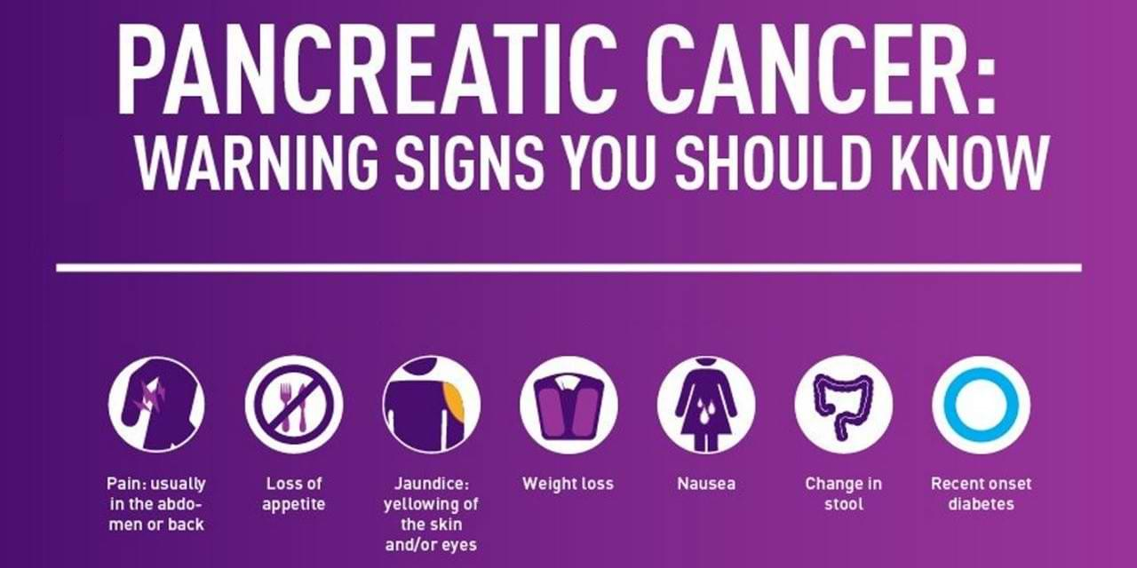
Know the signs. Get checked.

Slide 115
Closing Thoughts
Competence means curiosity. Ethics means owning your choices. Well-being means remembering you’re a person first. Technology means opportunity — if used wisely. Saul Goodman said: “You never really know what kind of lawyer you are until you’re tested.”

Slide 116
Thank You
Michael Kennedy Vermont Bar Counsel mkennedy@vtbarcounsel.org Ethical Grounds Blog: vtbarcounsel.wordpress.com Do good work. Be kind. And maybe go for a run.

Slide 117
But for the email, ChatGPT nailed it! Thank You!
Michael Kennedy Vermont Bar Counsel
mkennedy@vtbarcounsel.org (actual: Michael.Kennedy@vtcourts.gov)
Ethical Grounds Blog: vtbarcounsel.wordpress.com Do good work. Be kind. And maybe go for a run.

