Slide 1
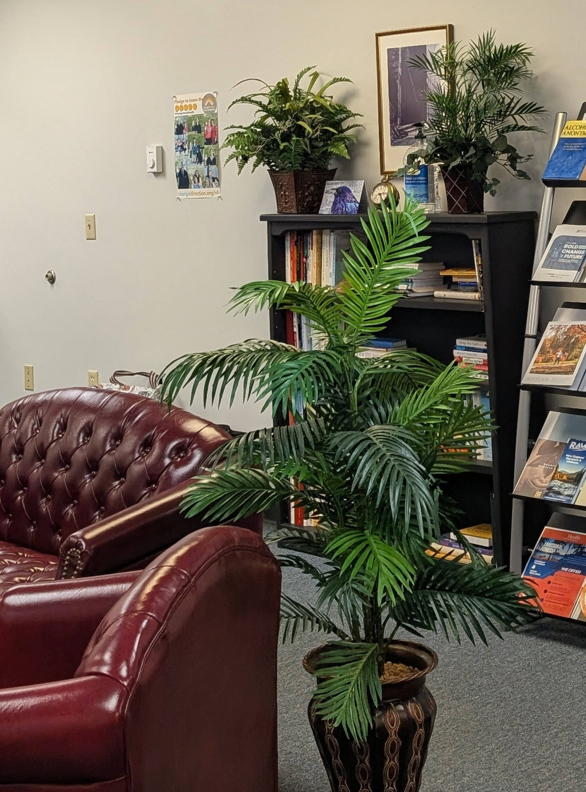
Transformative Leadership:
Promoting Attorney Well-Being Through Strategic Collaboration
Presented by the New England Lawyers Assistance Programs

Slide 2

Objectives
Identify Challenges: Examine the common issues faced by LAP callers to better understand and address their needs.
Explore Partnerships: Brainstorm strategies for collaboration with bar associations and other partners to strengthen our support systems for attorneys.
Notes:
Housekeeping- Dakotah ( 2 minutes):
Presentation is 75 minutes in length,
Review of presentation objectives (see below),
Sharing the QR Code, w/ Q&A/idea sharing @ end of presentation

Slide 3

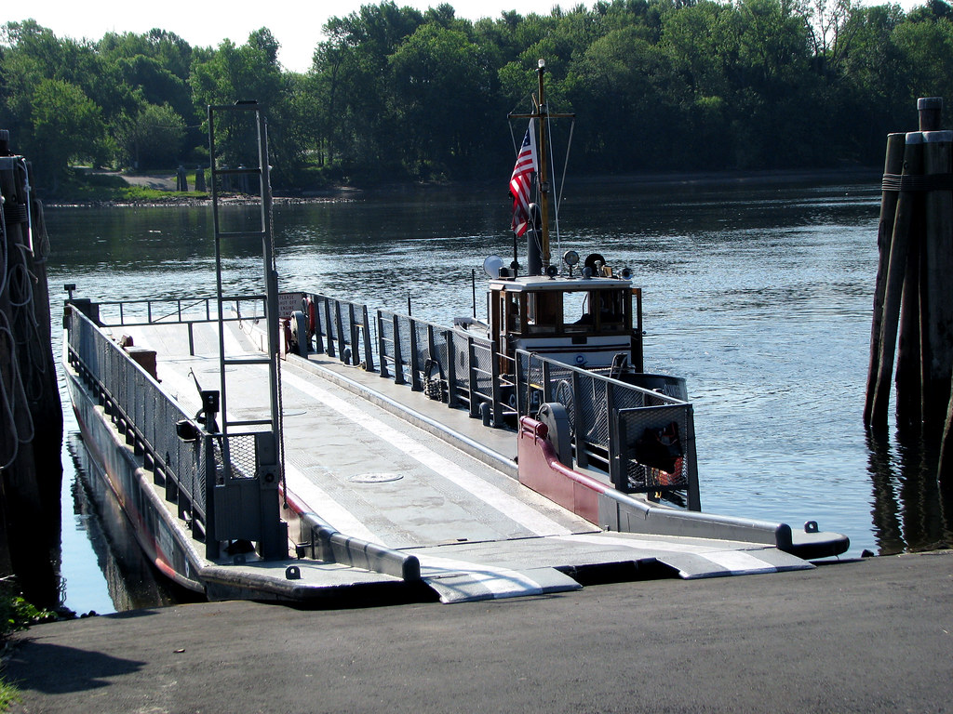
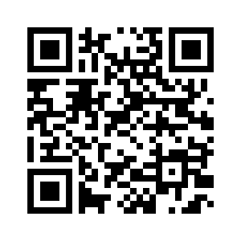
Lawyers Concerned For Lawyers, CT
Support and Help for the Legal Profession in Connecticut
Over 20,000 practicing lawyers in Connecticut.
Over the past year LCL–CT had over 1,000 participant at two support groups. Both are now hybrid—a bi-weekly peer support group and a weekly twelve-step based weekly meeting. The 12-step meeting attracts 10-20 attendees weekly.
The LCL-CT website is comprehensive and updated regularly with new links and resources.
LCL-CT offers six mental health sessions annually at no charge.
The LCL-CT endowment fund supports indigent attorneys in need intensive MH or SUD support.
Outreach includes regular presentations to three Connecticut Law Schools, Judges Pre-Bench Orientation and bar associations.

Slide 4


Maine Assistance Program for Lawyers and Judges (MAP)
Julia R. Teitel, Esq., Executive Director
Ella Brown, LCPC, Esq., Clinical Director
Number of attorneys, judges, and law students in Maine: approx. 6,500
Best achievement this year: Increasing MAP’s funding for the first time in the organization’s 23-year history.
Most effective outreach tool this year: Showing up in person.
Main objective for the coming year: Creating more robust stress and mental health peer support groups.

Slide 5


New Hampshire Lawyers Assistance Program
Total Number of attorneys: 8,800 approx.
Best Achievement(s) this year: Highest volume of program referrals since our inception, alongside a record number of requests for NHLAP presentations and Wellness CLEs
Most effective outreach tool(s) this year: Events attendance, word-of-mouth referrals. Collaborating with volunteers from Taproot to create engaging marketing materials for our "How We Help" initiative.
Main objective this coming year: Increase footprint in rural NH counties, complete website re-design to add multimedia resources and tools, diversify funding streams through NHLAP Fundraising Initiatives.

Slide 6


RI Lawyers Helping Lawyers Committee, RI Bar Association
LAP Directors: Cassandra Feeney, Nicholas Trott Long, co-chairs
Total Number of lawyers: approximately 5,000. All family members are eligible for the Bar’s EAP Service
Best Achievement(s) this year: increased outreach efforts; enhanced cooperation with Roger Williams University
Main objective this coming year: increase number of lawyers accessing services.

Slide 7


Vermont Lawyers Assistance Program
We have about 3300 licensed and 2800 active attorneys. I am available to them and law students (~500)
Biggest achievements this year have been through Attorney Assistance Panels involving individual attorneys sent through diversion.
Our most effective outreach tool: Word of mouth, Vermont Bar Counsel, Michael Kennedy, and VBA
Main objective this upcoming year: More on all fronts!

Slide 8

Prevalent Issues Among Lawyers
New England Bar Association
November 7th, 2025

Slide 9
Common Issues of Concern
Stress
Burnout
Anxiety
Depression
Neurodiversity

Slide 10

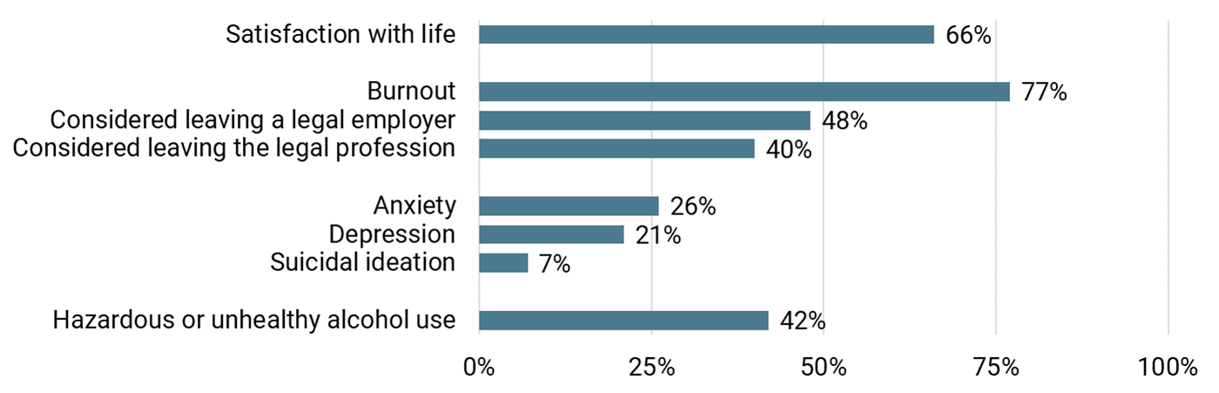
The State of Massachusetts Lawyers’ Well-Being: Overview
Lawyers reported concerning levels of burnout, anxiety, depression, and unhealthy alcohol use.
Note: High levels of satisfaction with life coexist with high levels of professional burnout.
Exhibit 1. Well-Being Among Lawyers in Massachusetts
  Notes: These results are from a weighted sample of 4,450 lawyers. Missing data were excluded.

Slide 11
The State of Massachusetts Lawyers’ Well-Being: Comparative Data
High rates of burnout among Massachusetts lawyers is consistent with previous studies on lawyer well-being.
Exhibit 2. Rates of Burnout Among Lawyers in Massachusetts and Utah
Massachusetts lawyers in 2022
Utah lawyers in 2022
  Notes: Results on Massachusetts lawyers are from a weighted sample of 4,450 lawyers with missing data excluded. Results on Utah lawyers is from Burnout and Engagement’s Relationship to Drug Abuse in Lawyers and Law Professionals by Ogbonnaya UC, Thiese MS, and Allen J.

Slide 12
The State of Massachusetts Lawyers’ Well-Being: Comparative Data
Rates of anxiety and depression are higher than previous studies on lawyer well-being and rates reported in nationally representative surveys of the general population.
Exhibit 3. Rates of Anxiety and Depression Among Lawyers in Massachusetts, California and DC, and the General Population
Massachusetts lawyers in 2022
California and DC lawyers in 2021
General population in early 2020
Massachusetts lawyers in 2022
California and DC lawyers in 2021
General population from 2015-2018
  Notes: Results on Massachusetts lawyers are from a weighted sample of 4,450 lawyers with missing data excluded.
  Results on California and DC lawyers is from Stress, drink, leave: An examination of gender-specific risk factors for mental health problems and attrition among licensed attorneys by Anker J, and Krill PR. General population data from early 2020 are from Anxiety reported by US adults in 2019 and during the 2020 COVID-19 pandemic: Population-based evidence from two nationally representative samples by Daly M and Robinson E. General population data from 2015-2018 are from NHANES.

Slide 13
Is it Burnout?
Is it Stress?
Is there a difference?

Slide 14
Broad Strokes
Burnout feels more like Depression:
  Lack of energy
  Disengagement
  Pessimism
  Etc.
Stress feels more like Anxiety:
  Worry
  Engagement (trouble disengaging)
  Energy activation
  Etc.

Slide 15
Fine Strokes: Stress
Eustress (positive stress)
  Motivates you to action
  Feelings of excitement
  Often improves performance
Distress (negative stress)
  Leads to avoidance
  Feelings of irritability
  Decreases performance
https://psychcentral.com/stress/eustress-vs-distress#negative-stress

Slide 16

Distress
Episodic or Chronic

Slide 17

A Driving Metaphor
Eustress
Episodic distress
Chronic distress
Burnout

Slide 18

Eustress
Interpretation of situation (interest/challenge)
View of self (Am I capable?)
Necessary supports (encouragement, resources, tools, etc.)

Slide 19

Episodic Distress
Time limited
Recover quickly afterward
Able to plan for repeated episodic events

Slide 20

Chronic Distress
Repeated distress
Takes an ongoing toll
Wears you down over time

Slide 21

Burnout
Out of gas, flat tires
Loss of meaning
Overwhelming exhaustion
Cynicism or detachment from the job
Feeling a lack of efficacy, being unproductive
The feeling stays with you

Slide 22

                What is Substance Use Disorder or SUD?
Primary Disease
Progressive
Fatal
Treatable
Relapse is common
Genetics play a part
Denial is a hallmark of the disease
Notes:
So what is a substance use disorder? This list boils down the elements of one may find with respect to most substance use disorders. Many LAP’s got their start addressing alcohol use in the profession. That was exactly the case in Connecticut. In a nutshell, the substance use disorders get worse over time, and this progression can result in death directly or indirectly (accidents, suicides, car crashes). Job performance and personal health can be gravely impaired. SUD can be treated or managed, usually by abstinence. There may be a genetic component. Denial on the part of the individual afflicted with SUD is a major hurdle to recovery.

Slide 23
2016 Hazelden/ABA Study re: Substance Use and Mental Health in Attorneys
Survey of 19,000 U.S. practicing attorneys~
20.6% Reported Problem Drinking
(approx. 1 in 5)
47.7% Problem developed in 1st 15 yrs. of practice
28% Reported suffering from depression
19% Reported suffering from anxiety
11.5% Reported suicidal thoughts
0.7 Reported suicidal attempt
63% Reported never seeking help
Krill, et al/JAMA, Vol 10, No. 1, Jan/Feb 2016
Notes:
How common is SUD among attorneys? There are many studies large and small. This 2016 survey by Patrick Krill is currently being updated with new research. I do not expect the findings to deviate. The legal profession brings many challenges. Conflict every day. Vicarious trauma due to exposure to other’s pain (as in family, criminal and child protection). The requirement to perform under intense conditions and pressure with long hours. Isolation does not help. Using substances to take the edge off is one way to cope—until it no longer works and creates issues of its own. The numbers are on the screen. We know that many if not most lawyers are loathe to take steps even when they know that their health and relationships are disintegrating due to SUD.
That’s enough from me. Here is Attorney Kennedy with a wrap on SUD including hope.

Slide 24
Alcohol misuse 2X as likely among lawyers as among general population
10% of adults in US have a substance use disorder.
18% of lawyers who have practiced 2--20 years
25% of lawyers practicing more than 20 years
10–20% of legal professionals will deal with an addictive disorder during their career.
Notes:
So what happens to lawyers over time? Generally, stress can wear down one’s resilience. Escape is so easy. Lawyers are among the most vulnerable population along with medical professionals, airline pilots and police officers. Occupations that support mental health but asl render it difficult for individuals to access such help in a private, confidential and safe way. Lawyers are not inclined to take the risk of being revealed or exposed for simply addressing a difficult personal issue. Lawyer Assistance Programs can offer that privacy.

Slide 25
Effectiveness of Lawyer Specific Treatment:
• Of those who reported past treatment for alcohol or drug use 21% reported utilizing treatment programs specifically tailored to legal professionals
• This 21% had significantly lower rates of problematic drinking than those who reported past treatment for alcohol or drug use that was not tailored for legal professionals
Barriers to Attorneys Seeking Treatment:
Not wanting others to find out that they need help
Concerns regarding privacy or confidentiality
Krill, Johnson, Albert, The Prevalence of Substance Use and Other Mental Health Concerns Among American Attorneys, 10 Journal of Addiction Medicine, 46 (2016):
Notes:
What are some barriers to getting help? Stigma number one. Not wanting anyone to know. This is perhaps the biggest deterrent to help. All the Lawyer Assistance Programs know this and work overtime to be sure there is anonymity, confidentiality and support. Peer to peer support is highly effective. Making a connection with attorneys who have been there, done that, maybe worse that you. Now those attorneys are better than ever in many ways. They become even better advocates with balanced personal and family lives.

Slide 26
Connecticut LCL Programs
Six Mental Health sessions—confidential and at no cost. No records kept.
Weekly live/Zoom meetings in Rocky Hill
Bi-Weekly meetings in Old Saybrook
Bi-weekly peer support group moderated by a clinician. Hybrid.
Endowment program for indigent attorneys
24/7 availability.
A website with many links and resources.
Notes:
Before we embark on a four-minute intro to SUD, this is what we at LCL in Connecticut offer---(run down screen quickly)

Slide 27
The Good News…
With Treatment, Recovery Is Possible
      Successful Recovery Rates:
      Professionals: as high as 90%
      General Population: 40% - 60%
Note: Fewer disciplinary cases involve lawyers in recovery than involve other lawyers
Notes:
So Here is the good news--Lawyer specific programs are very successful. A durable and lasting recovery. Lawyer Assistance Programs provide a safe and private place just to get info and put a toe in the water. In Connecticut, no records kept and no one will come looking for you if you wish to be on your own. Any process evolves at your pace. We have resources that may provide a better it for lawyers. There is no need to wait for an ultimatum from some authority or for an adverse event to take place.

Slide 28


Aging and Cognition

Slide 29
Vermont Data
Age Cohort % of All Active Attorneys (2823)
60–64 11.34% (320)
65–69 9.03% (255)
70–74 6.91% (195)
75–79 3.72% (105)
80–84 1.52% (43)
85+ 0.25% (7)
Total (60+) 32.77% (925)

Slide 30
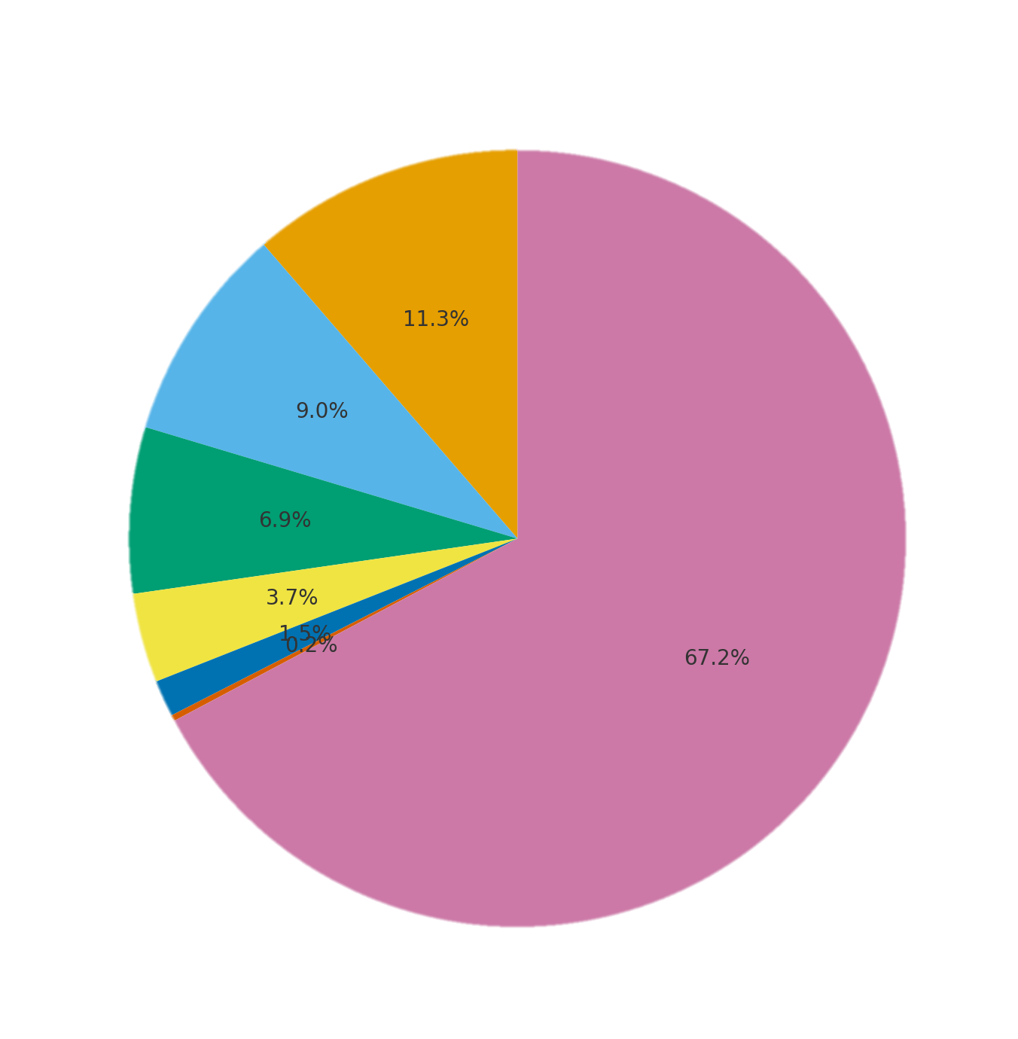
Distribution of All Active Attorneys by Age Cohort
60-64
65-69
70-74
75-79
80-84
85+
Under 60

Slide 31
Vermont Resources
(and what they reflect about approaching the problem)
Vermont has a FEMA model
  Disaster response and recovery
    Lawyers can be engaged for triage and wind down
      At most this is “low bono” work
      Many insurers now require solos to have a designated “back up” attorney
  Anecdotally Vermont is pretty typical just closer to the edge but the States in better shape have more resources devoted to LAP and especially overflow into Law Office Management Assistance – which is an excellent entry point for Bar Associations

Slide 32
Maine Data (as of 2018)
Age Cohort | % of All Active Attorneys | (5,406)
60-64 | 13.49% | (729)
65-69 | 10.82% | (585)
70+ | 10.75% | (195)
Total (60+) | ~35.00% | (581)

Slide 33
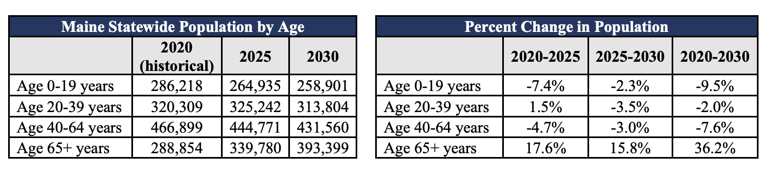
Source: Maine.gov

Slide 34
If an attorney is unwilling to retire
Maine Assistance Program for Lawyers and Judges
Maine Board of Overseers of the Bar

Slide 35
Why would an attorney continue to practice while in active cognitive decline?
Their genuine, subjective perception is that they are fine/nothing has changed
No one in their life has told them, to their face, that others are noticing that something is going on
Denial
Fear
They have no one to take over their caseload
If they retire, there won’t be any attorneys left in their area
They don’t know what they would do or who they would be if they were not practicing law

Slide 36
Opportunities to Divert or at least Prepare for the Gray Tsunami
Developing a culture for the off ramp (firm vs. solo challenges)
CLEs on the topics but also ETHICS and using ethical obligations as tools for encouraging support of colleagues
Destigmatize the fact that aging affects each and every one of us
Encouraging attorneys to cultivate interests, passions, and identities wholly unrelated to the practice of law
Creating a “life after law”
  Volunteer/pro bono opportunities
  Regular meetups for retired attorneys (AND JUDGES)

Slide 37
What can we learn from other professions?
Medicine offers the strongest clinical infrastructure (PHP + monitoring contracts) — a model law could borrow for serious impairment cases.
Accountancy demonstrates work-product peer review as a non-discriminatory way to detect declining performance.
Educationshows the value of anti-discrimination-compliant phased retirement and planned transitions.
Psychology (like law) share ethics-driven, dignity-preserving guidance with confidential assistance but ahead on stigma.

Slide 38

Impact of Mental Health and Substance Use Concerns in Professional Practice:
1. Mental impairment does not lessen a lawyer’s obligation to provide clients with competent representation.
2. Lawyers experiencing substance use disorders, mental health conditions, physical illnesses, or personal issues may struggle to deliver competent services. They may take on work they are not equipped to handle, despite having the necessary education and skills.
3. Conditions such as depression, anxiety, and substance misuse can lead to difficulties with follow-through, attention, integrity, trustworthiness, prompt responses, and diligence.
4. Often, these challenges can obscure a lawyer’s ability to recognize their limitations. Additionally, economic pressures may compel them to engage in matters that exceed their competency.
There is a connection between these struggles and potential ethical violations and discipline involvement.

Slide 39
Problematic Behaviors Related to Lawyer Mental or Physical Health and Substance Use Concerns with Potential Ethical Consequences:
Practice-Related Issues:
- Missed deadlines
Last-minute requests for extensions
Frequent absenteeism
Diminished quality of work product
Lack of communication with clients and/or colleagues
Failure to advocate for clients' interests
Tardiness or missed appointments and/or hearings
Errors in financial management
False/misrepresentations
Diminished memory or recall of details/conversations

Slide 40
Problematic Behaviors Related to Lawyer Mental or Physical Health and Substance Use Concerns with Potential Ethical Consequences: continued….
Attorney Signs:
- Acting different from prior functioning
Procrastination
Unpredictable/rapid mood swings
Unwarranted anger/hostility
Blaming others for personal failings
Drastic change in appearance
Frequent illnesses
Socially withdrawn

Slide 41
Lawyer/Judicial Regulations
In some states, LAPs do not work closely with the lawyer regulation system, perhaps because of a fear that such an affiliation could produce a chilling effect on program utilization.
However, LAPs in several states have an ongoing working relationship with lawyer regulation.
These programs may provide consultation to lawyer regulation staff to better understand impairment related to mental or physical illness or substance misuse, treatment outcomes, and the appropriate conditions and lengths of monitoring contracts
In some cases, staff from regulation and admission agencies serve on the LAP advisory committees and work on drafting rules pertaining to monitoring or conditional admission.
When they work together, LAPs, bar admission agencies, and lawyer regulation agencies can effectively combine resources to increase the health and wellness of the lawyer population and protect the public.

Slide 42
Confidentiality and Immunity
Undoubtedly one of the most important issues for legal professionals working with an LAP is confidentiality.
LAP Staff and Volunteers are exempt from reporting requirements to the lawyer regulation system.
LAPs with formal monitoring programs shield from oversharing personal health information to the disciplinary board(s).

Slide 43

ABA Rule 10- Model Rules for Lawyer Disciplinary Involvement
Factors to be Considered in Imposing Sanctions. In imposing a sanction after a finding of lawyer misconduct, the court or board shall consider the following factors, as enumerated in the ABA Standards for Imposing Lawyer Sanctions.
(1) whether the lawyer has violated a duty owed to a client, to the public, to the legal system, or to the profession;
(2) whether the lawyer acted intentionally, knowingly, or negligently;
(3) the amount of the actual or potential injury caused by the lawyer's misconduct; and
(4) the existence of any aggravating or mitigating factors.

Slide 44
“A healthy lawyer is a more competent lawyer.”
Lawyers who embrace accountability to their treatment and support programs see significant improvements in their overall health and well-being.
LAP Monitoring Programs play a crucial role in fostering long-term recovery, ensuring that lawyers not only return to practice safely but also thrive in their professional and personal lives.

Slide 45
Barriers to Accessing Help
Overcoming stigma
Fear of reputational harm
Confidentiality concerns

Slide 46
What Can Bar Associations Do?
Collaborate with your state’s LAP
  Ask your LAP how they can contribute to your efforts
  Ask how your LAP how you can promote their efforts
  Involve LAP staff on well-Being Committees, panels, etc.
Reduce stigma/offer validation of these issues through messaging and programming
  Offer free well-being programming to all lawyers in your state (to members and non-members)

Slide 47
Additional Strategies for Bar Associations to Enhance Lawyer Well-Being and Cultivate Partnerships with Lawyer Assistance Programs (LAPs).
1. Educational Programs on Well-Being:
- Offer dedicated educational programs on well-being topics and incorporate these themes into existing conferences and events.
- Continuing Legal Education (CLE): Partner with LAPs to host informative CLE sessions focusing on wellness, including burnout prevention, recognizing early signs of substance use disorders, and addressing neurodiversity.
2. Networking Opportunities
- In-Person Events: Organize regular networking events, such as monthly breakfasts for law sections and job fairs.
- Mentorship Programs: Facilitate connections between retiring practitioners and emerging lawyers to promote mentorship and ease transitions within the profession.
3. Community Building
- Informal Group Activities: Host relaxed social gatherings, such as hikes, bowling leagues, or book clubs, to foster informal connections among lawyers.
4. Support Networks for Retired Professionals
- Meetup Groups: Establish social groups for retired attorneys and judges and those nearing retirement to build lasting friendships and professional networks.
5. Inclusivity at Events: De-emphasize alcohol at events. Ensure formal events, such as galas and dinners, offer a variety of non-alcoholic beverage choices to accommodate all attendees.

Slide 48
Additional Strategies for Bar Associations to Enhance Lawyer Well-Being and Cultivate Partnerships with Lawyer Assistance Programs (LAPs).
6. Advocacy for Well-Being
- Supportive Policies: Advocate for initiatives that enhance lawyer well-being, such as personal leave policies like the Secured Leave Policy in North Carolina and the Presumptive Personal Leave Policy in Minnesota.
7. Destigmatization of Mental Health
- Awareness Initiatives: Implement programs aimed at reducing stigma around mental health and addiction, by sharing lived experiences including publishing articles authored by members in newsletters.
8. Assessment of Well-Being Initiatives
- Surveys Participation: Engage in the Lawyer and Judicial Well-Being Surveys to assess attitudes and resources related to lawyer well-being.
9. Wellness Discussions at Events
- Promote Supportive Services: Allocate time during events for discussions on wellness issues and available supportive services, collaborating with LAPs for speaker recommendations.
10. Marketing Support for LAPs
- Enhance Visibility: Provide free marketing assistance to amplify the outreach and presence of LAPs.

Slide 49
Additional Strategies for Bar Associations to Enhance Lawyer Well-Being and Cultivate Partnerships with Lawyer Assistance Programs (LAPs).
11. Resource Sharing on Well-Being
- Educational Materials: Distribute resources that support well-being, making them accessible through emails, websites, and newsletters. This should include information about LAPs, Employee Assistance Programs (EAPs), free therapy sessions, and mentorship programs.
- Training for Bar Staff: Ensure bar staff are knowledgeable about available wellness resources and can make warm referrals to LAPs.
- LAP Staff Education: Train LAP staff on practice management resources available through bar associations and other vendors.
12. Well-Being Committees
- Dedicated Committee: Form committees focused on promoting lawyer well-being, ensuring that these topics are integrated into all committee activities and relayed back to the Well-Being Committee for continuous improvement.
13. Recognition Programs
- Awards for Contributions: Establish awards such as the Wellness Ambassador Award and the Industry Leader in Wellness to recognize and honor exceptional contributions to lawyer well-being.
---
These strategies aim to cultivate a supportive environment that prioritizes the well-being of lawyers, encourages collaboration, and promotes a healthy legal profession.

Slide 50
Questions?

